Slide 1
FS/CST Exam: Prep to Recovery
Jerry Mahun, PLS
jerry.mahun@gmail.com
715-896-3178
https://jerrymahun.com
Studying for an exam is like drinking from a firehose.

Slide 2
Exam Administration
FS: Fundamentals of Surveying
NCEES: National Council of Examiners for Engineering and Surveying
NCEES.org
CST: Certified Survey Technician
NSPS: National Society of Professional Surveyors
CSTNSPS.com

Slide 3
Exam Administration
Learn the Rules
Exam Material Coverage
Open-book rules
Calculator policy
Application process & fee
Complaint/Follow-up policies

Slide 4
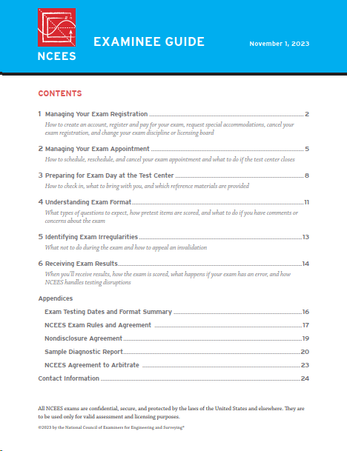
Getting Ready: Downloads
1. Examinee Guide
Rules and regulations for all NCEES administered exams.
Pay particular attention to the Sample Diagnostic Report for Exams appendix.

Slide 5
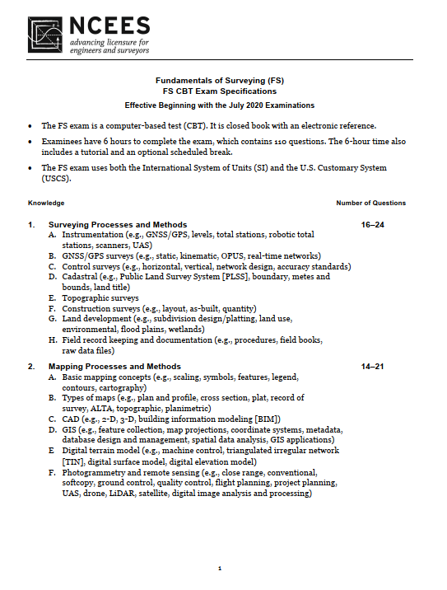
Getting Ready: Downloads
2. FS Exam Specifications
Computer-based
6 hour, 110 questions
Seven Knowledge Areas (KA)
Range of questions per KA
Subjects/Topics

Slide 6
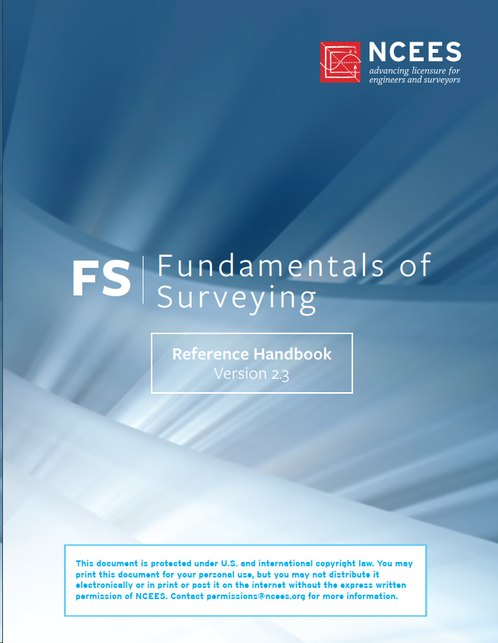
Getting Ready: Downloads
3. FS Reference Handbook
The only open book reference you may use during the exam
188 pages long
Learn its content & organization
Familiarize yourself with differing nomenclature

Slide 7
Getting Ready: Downloads
3. FS Reference Handbook
Sec 1. Abbreviations & Acronyms
Sec 2. Conversions and Other Useful Relationships
Sec 3. Mathematical & Surveying-Related Formulas
Sec 4. Economics
Sec 5. Ethics
Sec 6. Safety

Slide 8
Getting Ready: Downloads
3. FS Reference Handbook
Appendices
NSPS Model Standards
Minimum Standard Detail Requirements for ALTA/NSPS Land Title Surveys
United States National Map Accuracy Standards

Slide 9
Getting Ready: Downloads
3. FS Reference Handbook
Appendices
FGCS Specifications & Procedures to Incorporate Digital/Bar-Code Leveling Systems
FEMA Elevation Certificate and Instructions
Geospatial Positioning Accuracy Standards

Slide 10
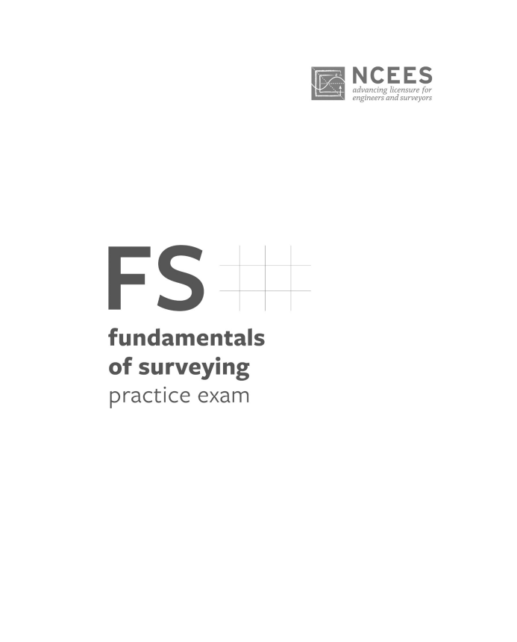
Getting Ready: Downloads
4. FS Practice Exam - Optional
50 questions from previous exams
Same format as FS exam
Worked solutions
$18.95
Free preview with missing pages available

Slide 11
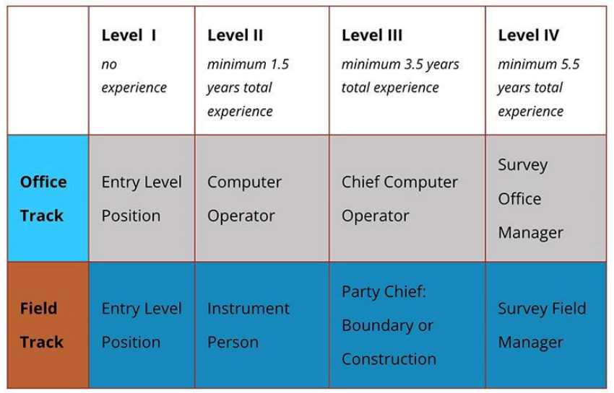
Getting Ready
Exam Levels
Level | # Quest | Time
I | 200 | 4 hrs
II | 130 | 4 hrs
III | 110 | 4 hrs
IV | Single essay question take home exam.
All exams are open-book.

Slide 12
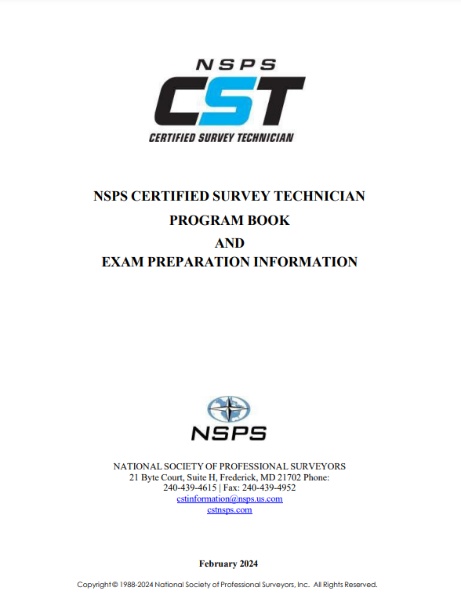
Getting Ready: Downloads
Program Book
General CST program info
Application process
Calculator policy

Slide 13
Getting Ready: Downloads
Program Book
By Level:
Typical position description
Work Elements
Subjects/Topics
Number of questions for exam

Slide 14
A. Professional Library
Reference Material
You should have a set of reference materials
Not just exam prep – you will refer to the material in your practice.
May be hard copy or digital

Slide 15
A. Professional Library
Area | Title or type
Basic principles | Recent editions of: a. General surveying textbook b. Photogrammetry textbook
Boundary principles | Brown’s Boundary Control and Legal Principles Evidence and Procedures for Boundary Location Clark on Surveying (optional) Writing Legal Descriptions
PLSS ¹ – General | Manual of Surveying Instructions - 2009 Manual of Surveying Instructions - 1973
PLSS ¹ - Historic | A History of the Rectangular Survey System Previous Manuals of Instructions
Dictionaries | Definitions of Surveying & Associated Terms; NSPS Blacks’ Law Dictionary Glossary of BLM Surveying and Mapping Terms¹
¹Available online

Slide 16
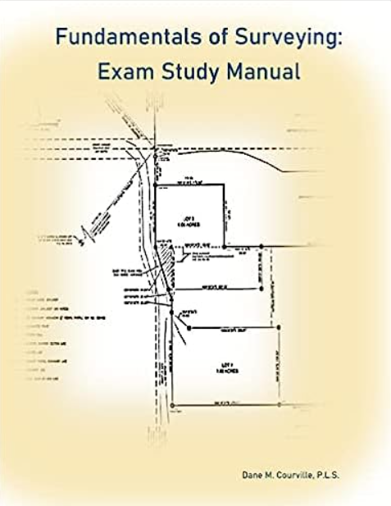
B. Other Resources
1. FS Exam
WFPS: FS Video Study Course & Manual
https://www.wfps.org/publications.html
NLC Prep: FS Review Course
https://nlcprep.com
State Surveying Assoc.
Some offer review materials and/or sponsor review sessions.

Slide 17
B. Other Resources
2. CST Exam
Learn CST
https://learncst,com
Different courses & bundles

Slide 18
B. Other Resources
3. General/Specialized (free unless $)
Surveying and Mapping textbook
Open Textbook Library: https://open.umn.edu/opentextbooks/
The Nature of Geographic Information
Open Geospatial text: https://www.e-education.psu.edu/natureofgeoinfo/
GPS and GNSS for Geospatial Engineers
https://www.e-education.psu.edu/geog862/node/1407

Slide 19
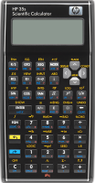
B. Other Resources
3. General/Specialized
Open Access Surveying Library
https://jerrymahun.com
GeoLearn ($)
https://geolearn.wcea.education
HP-33s & -35s Programs
https://jerrymahun.com: Home | Software | HP Calculator Resources

Slide 20
B. Other Resources
3. General/Specialized
Mentoring Mondays – many applicable sessions
https://mentoringmondays.xyz
Wisdom Wednesdays
https://wisdomwednesdays.xyz
Past book: Evidence and Procedures for Boundary Location
Current: Writing Legal Descriptions

Slide 21
C. Pre-Exam
1. Identify Weak areas
Go through FS KA or CST WE and physically mark weak or unfamiliar areas.
Use to formulate a study plan.
The topics in the KA and WE aren’t necessarily in learning order.

Slide 22
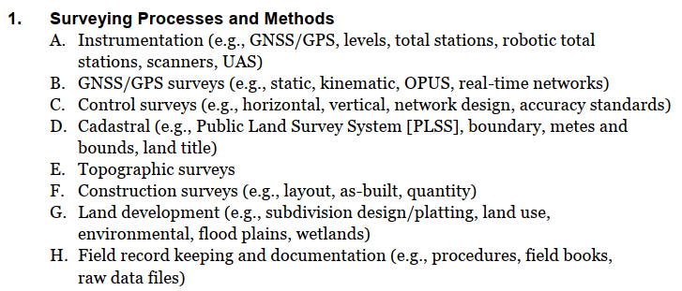
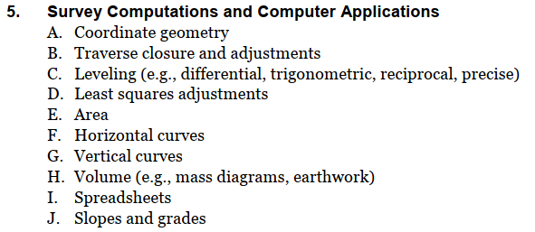
C. Pre-Exam

Slide 23
C. Pre-Exam
2. Reviewing or Learning?
Honest assessment: do you have the academic background?
Review materials are intended to review surveying, not teach it.
You should have already been exposed to most of this material.

Slide 24
C. Pre-Exam
2. Reviewing or Learning?
Depending on review material without an adequate background will make passing exams that much harder if not impossible.
Only 98%? Why can’t I be 100% confident?
Nope, doesn’t makes sense holding it this way either

Slide 25
C. Pre-Exam
3. Study Time
Consistent time and location.
Fewest distractions
Don’t just read – do.
Working out problems and taking notes mentally reinforces the material
“I remember doing a similar problem...”

Slide 26
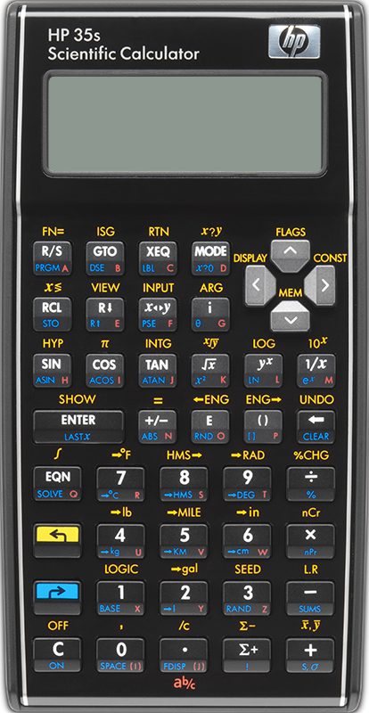
C. Pre-Exam
3. Study Time
Gonna use an HP-33s or -35s w/software and have never used an HP before? Learn how to:
perform basic RPN comps
set it up (display, angle mode, etc)
change batteries w/o trashing the software
do basic statistics

Slide 27
C. Pre-Exam
3. Study Time
Develop habits to use on the exam
Use sketches where applicable to illustrate narrative problems
Perform comps neatly so they are easy to follow and/or track down errors.
When you get an answer, ask yourself if it makes sense.

Slide 28
C. Pre-Exam
3. Study Time
FS Exam: use the Reference Handbook for equations, conversion factors, etc.
CST Exam: narrow down your references to a reasonably luggable pile.
Know material location to spend
less time flipping pages

Slide 29
C. Pre-Exam
4. Getting More Help
Mentoring Mondays (MM)
Check archives (ditto WW).
If not covered and you think it beneficial, ask Trent if a session can be scheduled.
MM contact spreadsheet – I added a column if a person would be willing to answer questions.

Slide 30
D. Taking the Exam
1. Don’t Brute Force It!
Go through the exam doing the questions you can do immediately
Skip over the ones you can’t
Later material may give you a hint/clue on the earlier difficult questions
Get an idea of content and organization

Slide 31
D. Taking the Exam
2. Read Each Question Carefully
Sometimes your mind sees something different from what your eyes do:
A Township is 6 miles square
vs
A Township is 6 square miles

Slide 32
D. Taking the Exam
2. Read Each Question Carefully
Determine exactly what’s being asked to avoid extra comps.
Tough one: Answer non-computational questions based on what is provided, not on how your company may do things.

Slide 33
D. Taking the Exam
3. Don’t Leave Any Questions Unanswered
No answer gets no points.
If all else fails you have a 25% chance guessing.
Can maybe narrow the odds: toss choices that don’t make sense.

Slide 34
D. Taking the Exam
4. Done Ahead of Time?
Make sure all questions are answered.
Revisit questions that may have been difficult or confusing.

Slide 35
E. Post-Exam
1. Summarize your experience
Go through the FS KA or CST WE and make notes on which:
were difficult
you felt totally unprepared for
you felt adequately prepared for

Slide 36
E. Post-Exam
1. Summarize your experience
Compare these notes (your interpretation) to the exam diagnostic (actual performance) when you receive it
Use this information to augment your study plan should you need to repeat the exam.

Slide 37
E. Post-Exam
2. Decompress
Have a beer, or
Play a vicious game of pickleball, or
Veg out on your favorite Netflix/Prime/Apple TV series, or
Spend some quality time with your family who’s taken a back seat to that d*** exam.

Slide 38
Questions?

