Slide 1
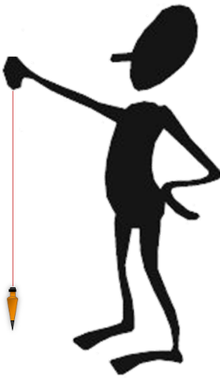
Mentoring Mondays
Measurement & Computation Errors
Mon 29 Nov and Mon 06 Dec
Jerry Mahun, PLS
Retired and a burden on my wife

Slide 2

Contents
29 Nov
I. Numbers
  A. Type
  B. Communication
  C. Sig Fig
II. Measurement Errors
  A. Quality
  B. Error Tenets
  C. Error Sources
  D. Error Types
  E. Behavior
  F. Minimizing
III. Random Errors
  A. Basic Analysis
  B. Error Propagation
IV. Least Squares Adj
  A. Compared to Simple Adj
  B. Complex Networks
  C. Redundancies
  D. Weights
  E. Linar/Non-Linear
  F. Adjustment Statistics
Next Week

Slide 3
  The description of a property line says to go:
    “200 ft to a half-inch iron pin;”
  A half-inch iron pin is found at 175.24 feet.
    Does this pin fit the description?
description: 200 ft
measured: 175.24 ft
Are these two distances the same?
  200 ft
  200.00 ft

Slide 4
  The description of a property line says to go:
    “200 ft to a half-inch iron pin;”
  A half-inch iron pin is found at 175.24 feet.
    Does this pin fit the description?
description: 200 ft
measured: 175.24 ft
Are these two distances the same?
  200 ft
  200.00 ft
Same magnitude
Different accuracy

Slide 5
A. Numbers
  1. Exact - infinite sig fig (sf); eg, counting, some conversions.
    Errors-free.
      1 foot exactly = 12 inches exactly
      1 meter = 39.37 inches exactly (survey foot)
      1 inch = 2.54 cm exactly (int’l ft)
  2. Inexact - finite sf; eg, measurements, some conversions, estimates.
    Are subject to errors.
      Approximations:
        1 meter is about 3 feet
        p = 3.14

Slide 6
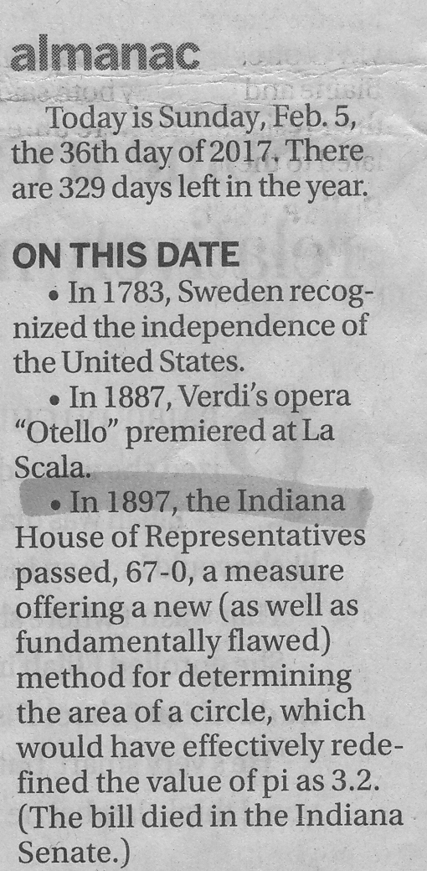
A. Numbers
  1. Exact - infinite sig fig (sf); eg, counting, some conversions.
    Errors-free.
      1 foot exactly = 12 inches exactly
      1 meter = 39.37 inches exactly (survey foot)
      1 inch = 2.54 cm exactly (int’l ft)
  2. Inexact - finite sf; eg, measurements, some conversions, estimates.
    Are subject to errors.
      Approximations:
        1 meter is about 3 feet
        p = 3.14

Slide 7
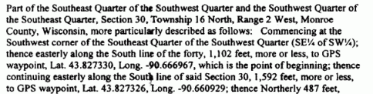
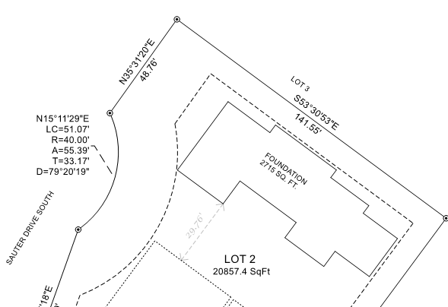
B. Communication
  The way a number is presented conveys a magnitude (size) and accuracy (resolution).
  Descriptions
    Maps

Slide 8

C. Significant Figures; 1. Definition
  Sig Fig (sf) are all digits in a number that are certain plus an additional one that is estimated.
Top view - two stakes
Measure distance with a 100 ft steel tape.
0
99
100
Tape is divided down to 0.1 ft.
Can read directly to 0.1 ft, estimate to 0.01 ft.
Read and record: 99.84
Certain:
3 digits
Estimate:
1 digit
→ 4 sig fig

Slide 9
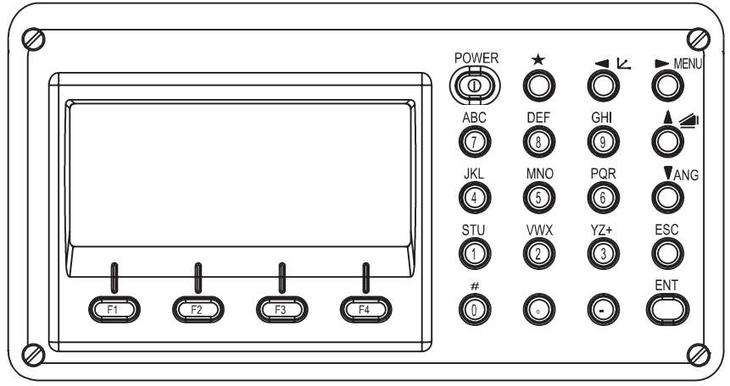
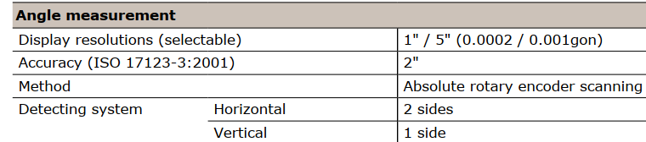
C. Significant Figures; 1. Definition
  Digital displays? No interpolation? Exact numbers?
V : 103°44’58”
HR: 10°15’31”
SD: 156.987 f
Sokkia SET62 display and specs
MEAS MODE S/A P1

Slide 10
C. Significant Figures; 2. Which digits are significant?
1. All non-zero digits |  |  |  | 125  3 sf
2. Zeros are significant if:
 | a. between non-zero digits |  |  | 10025  5 sf
 | b. right of non-zero digits & right of decimal |  |  | 1.24500  6 sf
 | c. right of non-zero digits & left of decimal point |  |  | 3250.  4 sf
3. Zeros are not significant (place holders only) if:
 | a. left of non-zero digits | a. left of non-zero digits |  | 0124  3 sf 0.00098  2 sf
 | b. right of non-zero digit & left of implied decimal point | b. right of non-zero digit & left of implied decimal pt |  | 4000  1 sf

Slide 11
C. Significant Figures; 3. Math operations
  Calculation result can only be as accurate as the least accurate number used.
  Add/subtract
  Multiply/divide
    Product has same sf as the least number of sf of the two factors.
 | 95.200
 | 912.1
 | 34.24
 | 100 |  least accurate
Raw answer = | 1141.54 | = 1100
 | 13.1 |  3 sf
 | x 147.25 |  5 sf
Raw answer = | 1928.975 | = 1930  3 sf
Mult/Div rule also applies to trig functions and roots

Slide 12
C. Significant Figures; 4. Computation Errors
  Most comp errors are due to:
    Wrong or approx. conversion factors
    Rounding bias, not carrying sufficient digits
  Area in square yards of a 65.32 ft long 130.19 ft wide rectangular field?
65.32 ft
4 sf
130.19 ft
5 sf
A=L x W

Slide 13
A. Quality
  Accuracy
    Absolute nearness to true value; measurement with minimal errors.
  Precision
    Repeatability; spread of a measurement set.
    Similar error behavior in repeated measurements
  Resolution
    The smallest division to which the measurement can be expressed base on the instrumentation used.
0
9
10
Ex: 9.84, 9.83, 9.84

Slide 14


A. Quality
(a)
(b)
(c)
(d)

Slide 15
A. Quality
  Resolution
    Higher resolution gives better accuracy (in theory)
20
30
40
50
20
30
40
50
20
30
40
50
10
10
10
0
0
0
direct: 10°
interpolate: 1°
direct: 5°
interpolate: 1°
direct: 1°
interpolate: 0.5°

Slide 16
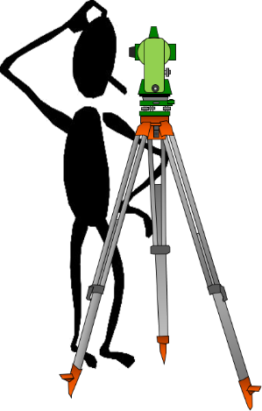
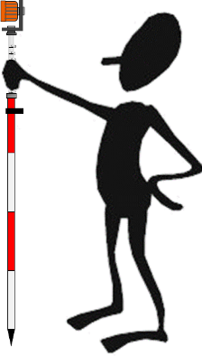
B. Error Tenets – individual measurements
  No measurement is exact.
  Every measurement contains errors.
  The true value of a measurement is never known.
  The exact error present in a measurement is unknown.

Slide 17

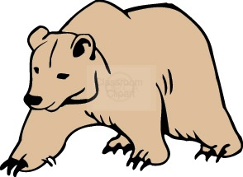
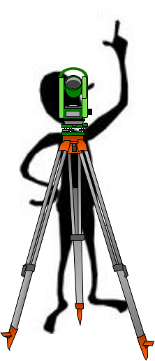

C. Error Sources
  Where they come from
  1. Natural
    Environment within which a measurement is made

Slide 18

C. Error Sources
  Where they come from
  2. Instrumental
    Measuring equipment condition
43
45
46
0.0 ft
92.35 ft
LoS
Horizontal

Slide 19
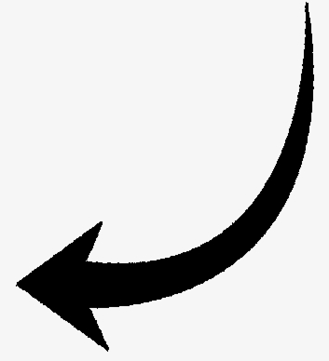
C. Error Sources
  Where they come from
  3. Personal
    People making the measurement

Slide 20
D. Error Types
  How they behave
  1. Mistake
    Carelessness or misunderstanding
  2. Systematic
    Conform to mathematical or physical law
  3. Random
    Remaining error after mistakes & systematic errors are eliminated
    Tend to be small; as likely positive as negative.

Slide 21
E. Behavior
Systematic errors
compensated; good procedures
Good procedures but systematic error(s)
present
(a)
(b)
Incorrect procedures
Mistake to let this shooter near a weapon
(c)
(d)

Slide 22
E. Minimizing; 1. Mistake
  Generally, with a single measurement, can’t tell if a mistake was made.
    Measure again
100’ steel tape, 70°F, 20 lb pull
362.24 ft
A
B
Distance = 362.24 ft?

Slide 23
F. Minimizing; 1. Mistake
  Generally, with a single measurement, can’t tell if a mistake was made.
    Measure again
    How to determine which is correct?
100’ steel tape, 70°F, 20 lb pull
362.24 ft
A
B
Distance = 362.24 ft?
100’ steel tape, 45°F, 20 lb pull
262.19 ft
A
B
Distance = (362.24+262.19)/2
= 312.22 ft?

Slide 24
F. Minimizing; 1. Mistake
  Generally, with a single measurement, can’t tell if a mistake was made.
    Measure again
    How to determine which is correct?
    Measure again.
100’ steel tape, 70°F, 20 lb pull
362.24 ft
A
B
Distance = 362.24 ft?
100’ steel tape, 45°F, 20 lb pull
262.19 ft
A
B
Distance = (362.24+262.19)/2
= 312.22 ft?

Slide 25

F. Minimizing; 1. Mistake
  Generally, with a single measurement, can’t tell if a mistake was made.
  Remeasure until all measurements are within an acceptable tolerance
  Tolerance can be defined as:
    A specific spread, eg, angles must all be within 10”
    A precision level, eg, distances must be within 1/5000
    Different based on equipment or personnel, eg, angles within 10” for experienced operator, 25” for new tech.
  Reject measurements outside the tolerance to avoid biasing good measurements.

Slide 26
F. Minimizing; 2. Systematic
  Apply a correction:
    Mathematic
    Mechanical
    Procedure
  Specific surveying procedures are used to:
    ensure measurement is made correctly
    allow some systematic errors to cancel
Adjust gun sight
or
Aim up & right.

Slide 27
F. Minimizing; 2. Systematic
  Example: Collimation error in a level
    Adjustment
      Perform peg-test
      Adjust cross-haile reticule
e₂
e₁
LoS
Horizontal
d₁
d₂

Slide 28
F. Minimizing; 2. Systematic
  Example: Collimation error in a level
    Computation
      Perform peg-test
      Determine collimation error rate, c (ft/ft)
      Reading error is e = c x d.
      Add error to rod reading.
e₂
e₁
LoS
Horizontal
d₁
d₂

Slide 29
F. Minimizing; 2. Systematic
  Example: Collimation error in a level
    Procedure
    Becasue the error is a function of distance, balancing BS and FS distances allows the error to cancel.
e_{BS}
LoS
LoS
e_{FS}
Horizontal
Horizontal
BS+e_{BS}
FS+e_{FS}
d_{BS}
d_{FS}

Slide 30
F. Minimizing; 2. Systematic
  Other common procedural compensations
    Leveling
    Total Station
Horizontal
Horizontal
Curvature and Refraction
(R+C)_{BS}
Level
Level
(R+C)_{FS}
Refracted LoS
Refracted LoS
Level
Level
VA
LoS path
Reverse LoS
Plate bubble run
Optical plummet
Double centering
Meas horiz angle D & R
VA
LoS path
Direct LoS
HA
HA
HA
HA
A
B
B
C
A
(a) Direct
(b) Reverse
(c) Average

Slide 31


F. Minimizing; 3. Random
    Appropriate equipment
    Knowledgeable personnel
    Favorable conditions
    Repeat measurements
      How many times?
      Example: FGCS Triangulation angle meas specs
Order/Class | 1st | 2nd / I | 2nd / II | 3rd / I | 3rd / II
Num Positions | 16 | 16 | 8 or 12* | 4 | 2
Max Std Dev of Mean | 0.4” | 0.5” | 0.8” | 1.2” | 2.0”
Reject Limit from Mean | 4” | 4” | 5” | 5” | 5”
*8 if 0.2” resolution instrument, 12 if 1”
A position is 1 D&R measurement

Slide 32
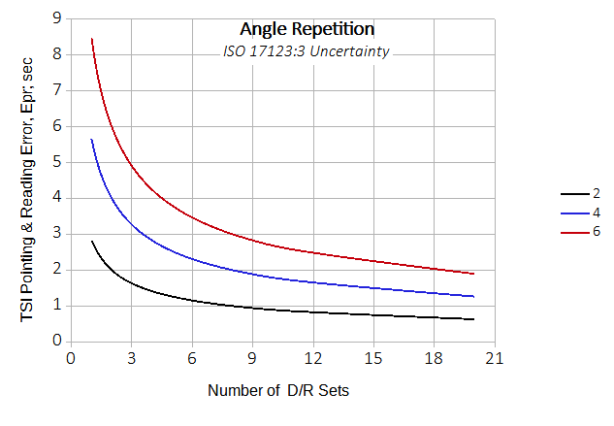
F. Minimizing; 3. Random
      Comparison of different resolution Total Stations
      Pointing and reading error

Slide 33
F. Minimizing; 3. Random
  A measurement must be independent, otherwise it is not redundant.
    Not changing conditions allows mistakes and systematic errors to be repeated.
LoS
LoS
e_{BS}
Leveling
From a single set up:
  (a) BS A and FS B
  (b) BS B and FS A
Collimation error does not compensate.
e_{FS}
Horiz
Horiz
B
(a)
A
LoS
LoS
e_{FS}
e_{BS}
Horiz
Horiz
B
(b)
A

Slide 34
F. Minimizing; 3. Random
  A measurement must be independent, otherwise it is not redundant.
    Change conditions (reset inst, resight tagets, diff day, combo, etc).
LoS
LoS
e_{BS}
Leveling
As a minimum, inst should be taken down and reset:
(a) Balance BS & FS dists;
BS A then FS B
(b) Reset inst with BS/FS dists balanced;
BS B then FS A
e_{FS}
Horiz
Horiz
B
(a) Initial setup
A
LoS
LoS
e_{FS}
e_{BS}
Horiz
Horiz
B
(b) Reset
A

Slide 35
F. Minimizing; 3. Random
  A measurement must be independent, otherwise it is not redundant.
    Change conditions (reset inst, resight targets, diff day, combo, etc).
Direct
Angle
Horizontal angle meas
Do not need to reset inst between angle meas, but:
  Resight BS and FS targets
  Reverse telescope
  Rotate horiz cicle
330°
0°
30°
300°
60°
270°
90°
240°
120°
210°
180°
150°
Reverse
Angle
Resight
Resight
330°
0°
30°
300°
60°
Rotated
circle
270°
90°
Reverse
scope
240°
120°
210°
180°
150°

Slide 36

F. Minimizing Errors
  To minimize errors:
    Favorable conditions
    Use proper equipment
    Trained personnel
    Correct procedures
    Reapeat measurements
  This will minimize but not eliminate errors.
  Only random errors will be left and they should be small.

Slide 37
A. Basic Analysis; 1. Terms
  Direct measurement
    Measure the unknown with instrumentation
  Indirect measurement
    Determine the unknown from measurements and computations
0
9
10
9.86 ft
BS
A
FS
Elev_{B} = Elev_{A}+BS_{A}-FS_{B}
B

Slide 38
A. Basic Analysis; 1. Terms
  Redundancy
    Also known as a degree of freedom (df)
    A measurement beyond what is needed to determine a quantity.
    Example: a horizontal distance is measured once
    1 measurement
    1 unknown – the distance
    0 redundancy
    Measure again
    2 measurements
    1 unknown
    1 redundancy
    etc.

Slide 39
A. Basic Analysis; 1. Terms
  Discrepancy
    Difference between any two measurements in a set
  Most Probabble Value (MPV)
    The most likely value of the unknown based on the measurement set.
    If all measurements are equal qulity, then the MPV is the arithmetic average.
      m: measurement
      n: number of measurements

Slide 40
A. Basic Analysis; 1. Terms
  Residual
    The difference between the MPV and a measurement.
  Least Squares
    The MPV is the value which minimizes the sum of the squared residuals.
    Least sum of the Squares.
    Any other number will increase the sum.
    This is based on statistical behavior of random errors.

Slide 41
A. Basic Analysis; 1. Terms
  Standard Deviation
    Precision indicator of a measurement set.
    Is approx. 68% of the area under the Normal Distribution curve
    The Normal Distribution curve is a graph of residuals frequency.
inflection
point
frequency
asymptotic
-σ +σ
0
residuals

Slide 42
A. Basic Analysis; 1. Terms
  Confidence Interval
  Certainty that a measurement will fall within a range.
    ±σ is a 68% CI
    90% CI ≈ 1.65(σ)
    95% CI ≈ 1.96(σ) aka 2 sigma 95% area under curve
    100% CI = ? 100% area under curve
-2σ
-1.65σ
-σ
0
+σ
+1.65σ
+2σ

Slide 43
A. Basic Analysis; 1. Terms
  Standard Error of the Mean
    σ is for the measurement set; precirion indicator
    E_{MPV} is the expected error in the MPV; expected accuracy indicator.
±E_{MPV}
±σ

Slide 44
A. Basic Analysis; 2. Example
Measurement |  | v, residual = MPV-meas | v²
num | value
1 | 45.66
2 | 45.68
3 | 45.66
4 | 45.65
sums: | 182.65

Slide 45
A. Basic Analysis; 2. Example
Measurement |  | v, residual = MPV-meas | v²
num | value
1 | 45.66
2 | 45.68
3 | 45.66
4 | 45.65
sums: | 182.65

Slide 46
A. Basic Analysis; 2. Example
Measurement |  | v, residual = MPV-meas | v²
num | value
1 | 45.66 | +0.002
2 | 45.68 | -0.018
3 | 45.66 | +0.002
4 | 45.65 | +0.012
sums: | 182.65

Slide 47
A. Basic Analysis; 2. Example
Measurement |  | v, residual = MPV-meas | v²
num | value
1 | 45.66 | +0.002 | 0.000004
2 | 45.68 | -0.018 | 0.000324
3 | 45.66 | +0.002 | 0.000004
4 | 45.65 | +0.012 | 0.000144
sums: | 182.65 |  | 0.000476

Slide 48
A. Basic Analysis; 2. Example
Measurement |  | v, residual = MPV-meas | v²
num | value
1 | 45.66 | +0.002 | 0.000004
2 | 45.68 | -0.018 | 0.000324
3 | 45.66 | +0.002 | 0.000004
4 | 45.65 | +0.012 | 0.000144
sums: | 182.65 |  | 0.000476

Slide 49

A. Basic Analysis; 3. Weights
  Different quality measuremens can be used together.
  Use relative weights to give better quality measurements greater effect.

Slide 50
A. Basic Analysis; 3. Weights
  Different quality measuremens can be used together.
  Example
Crew | Dist (ft) | Std Dev (ft)
1 | 352.11 | ±0.15
2 | 351.92 | ±0.38
3 | 352.35 | ±0.08
HO Typo

Slide 51
A. Basic Analysis; 3. Weights
  Different quality measuremens can be used together.
  Example
Crew | Dist (ft) | Std Dev (ft)
1 | 352.11 | ±0.15
2 | 351.92 | ±0.38
3 | 352.35 | ±0.08
sums: | 1056.38
HO Typo
Straight average

Slide 52
A. Basic Analysis; 3. Weights
  Different quality measuremens can be used together.
  Example
Crew | Dist (ft) | Std Dev (ft) | Weight
1 | 352.11 | ±0.15 | 44.44
2 | 351.92 | ±0.38 | 6.92
3 | 352.35 | ±0.08 | 156.25
Compute weights:
HO Typo
Straight average
Weighted average

Slide 53
A. Basic Analysis; 3. Weights
  Different quality measuremens can be used together.
  Example
Crew | Dist (ft) | Std Dev (ft) | Weight | w/6.92
1 | 352.11 | ±0.15 | 44.44 | 6.42
2 | 351.92 | ±0.38 | 6.92 | 1.00
3 | 352.35 | ±0.08 | 156.25 | 22.58
To make the numbers smaller, divide the weights by the samllest one: 6.92
HO Typo
Straight average
Weighted average

Slide 54
A. Basic Analysis; 3. Weights
  Different quality measuremens can be used together.
  Example
Crew | Dist (ft) | Std Dev (ft) | Weight | w/6.92 | w x m
1 | 352.11 | ±0.15 | 44.44 | 6.42 | 2260.55
2 | 351.92 | ±0.38 | 6.92 | 1.00 | 351.92
3 | 352.35 | ±0.08 | 156.25 | 22.58 | 7956.06
sums: |  |  |  | 30.00 | 10,568.53
HO Typo
Straight average
Weighted average

Slide 55
A. Basic Analysis; 4. Comparisons
  Two survey crews measure different horizontal angles multiple times.
 | Crew A | Crew B
Num of meas | 2 D/R | 4 D/R
Average angle | 128°18’15” | 196°02’40”
Std Dev | ±0°00’12” | ±0°00’14”
Which crew has better precision?

Slide 56
A. Basic Analysis; 4. Comparisons
  Two survey crews measure different horizontal angles multiple times.
 | Crew A | Crew B
Num of meas | 2 D/R | 4 D/R
Average angle | 128°18’15” | 196°02’40”
Std Dev | ±0°00’12” | ±0°00’14”
Which crew has better precision?
Crew A because their std dev is smaller.

Slide 57
A. Basic Analysis; 4. Comparisons
  Two survey crews measure different horizontal angles multiple times.
 | Crew A | Crew B
Num of meas | 2 D/R | 4 D/R
Average angle | 128°18’15” | 196°02’40”
Std Dev | ±0°00’12” | ±0°00’14”
Which crew has better precision?
Which crew has better expected accuracy?
Crew A because their std dev is smaller.

Slide 58
A. Basic Analysis; 4. Comparisons
  Two survey crews measure different horizontal angles multiple times.
 | Crew A | Crew B
Num of meas | 2 D/R | 4 D/R
Average angle | 128°18’15” | 196°02’40”
Std Dev | ±0°00’12” | ±0°00’14”
Which crew has better precision?
Which crew has better expected accuracy?
  Crew A:
  Crew B:
Crew A because their std dev is smaller.

Slide 59
A. Basic Analysis; 5. Angles & Random Errors
  Angle comps are a common rounding issue
num | value (DMS) | decimal | v=MPV-meas | v²
1 | 35°15’30”
2 | 35°15’56”
3 | 35°15’35”
4 | 35°15’47”
sums

Slide 60
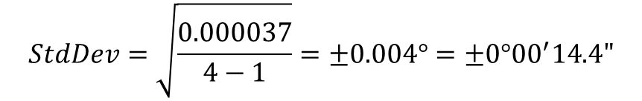
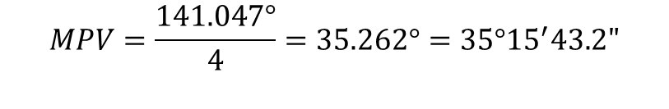
3 dp | 35°15’43.2” | ±0°00’14.4”
A. Basic Analysis; 5. Angles & Random Errors
Using 3 decimal places
num | value (DMS) | decimal | v=MPV-meas | v²
1 | 35°15’30” | 35.258° | +0.004 | 0.000016
2 | 35°15’56” | 35.266° | -0.004 | 0.000016
3 | 35°15’35” | 35.260° | +0.002 | 0.000004
4 | 35°15’47” | 35.263° | -0.001 | 0.000001
sums |  | 141.047° |  | 0.000037
$$MPV=\frac{141.047°}{4}=35.262°=35°{15}^{′}43.2"$$
$$StdDev=\sqrt{\frac{0.000037}{4−1}}=±0.004°=±0°{00}^{′}14.4"$$

Slide 61
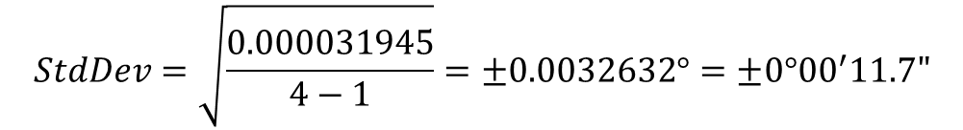
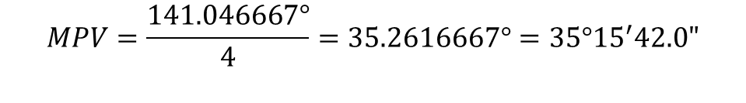
3 dp | 35°15’43.2” | ±0°00’14.4”
7 dp | 35°15’42.0” | ±0°00’11.7”
A. Basic Analysis; 5. Angles & Random Errors
Using 7 decimal places
num | value (DMS) | decimal | v=MPV-meas | v²
1 | 35°15’30” | 35.2583333° | +0.0033334 | 0.000011112
2 | 35°15’56” | 35.2655556° | -0.0038889 | 0.000015124
3 | 35°15’35” | 35.2597222° | +0.0019445 | 0.000003781
4 | 35°15’47” | 35.2630556° | -0.0013889 | 0.000001929
sums |  | 141.0466667° |  | 0.000031945
$$MPV=\frac{141.046667°}{4}=35.2616667°=35°{15}^{′}42.0"$$
$$StdDev=\sqrt{\frac{0.000031945}{4−1}}=±0.0032632°=±0°{00}^{′}11.7"$$

Slide 62
3 dp | 35°15’43.2” | ±0°00’14.4”
7 dp | 35°15’42.0” | ±0°00’11.7”
A. Basic Analysis; 5. Angles & Random Errors
Using smallest unit
num | value (DMS)
1 | 35°15’30”
2 | 35°15’56”
3 | 35°15’35”
4 | 35°15’47”
sums
Each angle begins with 35°15’ so subtract that from each

Slide 63
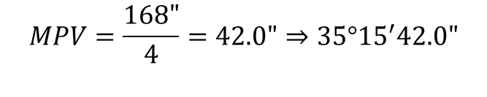
3 dp | 35°15’43.2” | ±0°00’14.4”
7 dp | 35°15’42.0” | ±0°00’11.7”
A. Basic Analysis; 5. Angles & Random Errors
Using smallest unit
num | value (DMS) | value-35°15’ | v=MPV-meas | v²
1 | 35°15’30” | 30"
2 | 35°15’56” | 56"
3 | 35°15’35” | 35"
4 | 35°15’47” | 47"
sums |  | 168”
$$MPV=\frac{168"}{4}=42.0"⇒35°{15}^{′}42.0"$$

Slide 64
3 dp | 35°15’43.2” | ±0°00’14.4”
7 dp | 35°15’42.0” | ±0°00’11.7”
A. Basic Analysis; 5. Angles & Random Errors
Using smallest unit
num | value (DMS) | value-35°15’ | v=MPV-meas | v²
1 | 35°15’30” | 30" | +12.0
2 | 35°15’56” | 56" | -14.0
3 | 35°15’35” | 35" | +7.0
4 | 35°15’47” | 47" | -5.0
sums |  | 168”
$$MPV=\frac{168"}{4}=42.0"⇒35°{15}^{′}42.0"$$

Slide 65
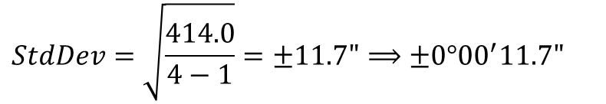
3 dp | 35°15’43.2” | ±0°00’14.4”
7 dp | 35°15’42.0” | ±0°00’11.7”
A. Basic Analysis; 5. Angles & Random Errors
Using smallest unit
num | value (DMS) | value-35°15’ | v=MPV-meas | v²
1 | 35°15’30” | 30" | +12.0 | 144.0
2 | 35°15’56” | 56" | -14.0 | 196.0
3 | 35°15’35” | 35" | +7.0 | 49.0
4 | 35°15’47” | 47" | -5.0 | 25.0
sums |  | 168” |  | 414.0
$$MPV=\frac{168"}{4}=42.0"⇒35°{15}^{′}42.0"$$
$$StdDev=\sqrt{\frac{414.0}{4−1}}=±11.7"⟹±0°{00}^{′}11.7"$$

Slide 66
A. Basic Analysis; 5. Angles & Random Errors
Using smallest unit
num | value (DMS) | value-35°15’ | v=MPV-meas | v²
1 | 35°15’30” | 30" | +12.0 | 144.0
2 | 35°15’56” | 56" | -14.0 | 196.0
3 | 35°15’35” | 35" | +7.0 | 49.0
4 | 35°15’47” | 47" | -5.0 | 25.0
sums |  | 168” |  | 414.0
Which way is simpler?
Converting DMS
num | value (DMS) | decimal | v=MPV-meas | v²
1 | 35°15’30” | 35.2583333° | +0.0033334 | 0.000011112
2 | 35°15’56” | 35.2655556° | -0.0038889 | 0.000015124
3 | 35°15’35” | 35.2597222° | +0.0019445 | 0.000003781
4 | 35°15’47” | 35.2630556° | -0.0013889 | 0.000001929
sums |  | 141.0466667° |  | 0.000031945

Slide 67
A. Basic Analysis; 5. Angles & Random Errors
  How about...
num
DMS
DMS − __________
v=MPV-meas
v²
1
107°03’58”
2
107°04’01”
3
107°04’03”
4
107°03’59”
sums

Slide 68
A. Basic Analysis; 5. Angles & Random Errors
num
DMS
DMS − __________
v=MPV-meas
v²
1
107°03’58”
2
107°04’01”
3
107°04’03”
4
107°03’59”
sums
Subtract 107°03’ from each angle.

Slide 69
A. Basic Analysis; 5. Angles & Random Errors
num
DMS
107°03’
DMS − __________
v=MPV-meas
v²
1
107°03’58”
58”
2
107°04’01”
61”
3
107°04’03”
63”
4
107°03’59”
59”
sums
241”

Slide 70
A. Basic Analysis; 5. Angles & Random Errors
num
DMS
107°03’
DMS − __________
v=MPV-meas
v²
1
107°03’58”
58”
2
107°04’01”
61”
3
107°04’03”
63”
4
107°03’59”
59”
sums
241”
107°03’00”+0°00’60.25”
= 107°03’60.25” = 107°04’00.2”

Slide 71
A. Basic Analysis; 5. Angles & Random Errors
num
DMS
107°03’
DMS − __________
v=MPV-meas
v²
1
107°03’58”
58”
+2.2”
4.84
2
107°04’01”
61”
-0.8”
0.64
3
107°04’03”
63”
-2.8”
7.84
4
107°03’59”
59”
+1.2”
1.44
sums
241”
14.76
107°03’00”+0°00’60.25”
= 107°03’60.25” = 107°04’00.2”

Slide 72
A. Basic Analysis; 5. Angles & Random Errors
num
DMS
107°03’
DMS − __________
v=MPV-meas
v²
1
107°03’58”
58”
+2.2”
4.84
2
107°04’01”
61”
-0.8”
0.64
3
107°04’03”
63”
-2.8”
7.84
4
107°03’59”
59”
+1.2”
1.44
sums
241”
14.76
107°03’00”+0°00’60.25”
= 107°03’60.25” = 107°04’00.2”
= ±00°00’02.2”

Slide 73
B. Error Propagation; 1. Simple
  When combining measurements to compute a third value, how do their errors affect the result?
    It depends on how they are combined.
  a. Error of a Sum
      Example: A soil specimen is divided into three sample parts which are separately weighed. What is the error in the soil’s total weight?
Soil sample | Weight
1 | 56.2 gr ±0.15 gr
2 | 28.9 gr ±0.21 gr
3 | 41.6 gr ±0.11 gr
Total wt = 127.6 gr ± gr

Slide 74
B. Error Propagation; 1. Simple
  When combining measurements to compute a third value, how do their errors affect the result?
    It depends on how they are combined.
  a. Error of a Sum
      Example: A soil specimen is divided into three sample parts which are separately weighed. What is the error in the soil’s total weight?
Soil sample | Weight
1 | 56.2 gr ±0.15 gr
2 | 28.9 gr ±0.21 gr
3 | 41.6 gr ±0.11 gr
Total wt = 127.6 gr ± 0.28 gr

Slide 75
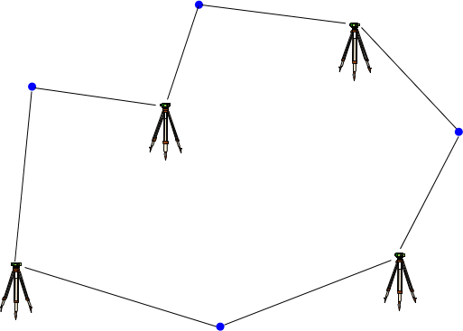
B. Error Propagation; 1. Simple
  b. Error of a Series
      Ex: Each time they set up a level, a survey crew can determine an elevation difference to ±0.015 ft. What is their expected misclosure on this loop?

Slide 76
B. Error Propagation; 1. Simple
  b. Error of a Series
      Ex: Each time they set up a level, a survey crew can determine an elevation difference to ±0.015 ft. What is their expected misclosure on this loop?

Slide 77
B. Error Propagation; 1. Simple
  c. Error of a Product
    A±E_{A}, B±E_{B} >> A x B
      Example: What is error in a rectangular field’s area based on the measurements of its sides?
186.1’±0.83’
97.6’±0.57’

Slide 78
B. Error Propagation; 1. Simple
  c. Error of a Product
    A±E_{A}, B±E_{B} >> A x B
      Example: What is error in a rectangular field’s area based on the measurements of its sides?
186.1’±0.83’
97.6’±0.57’

Slide 79
B. Error Propagation; 2. Combined
  a. Distance
    Manufacturer states an accuracy (MSA) for distance between the instrument and reflector, eg, ±(3 mm + 3 ppm)
    There are centering errors at the inst (E_{tsi}) and ref (E_{ref})
E_{ref}
MSA: ±(C+P)
E_{tsi}
D

Slide 80
B. Error Propagation; 2. Combined
  a. Distance
    Example: TSI setup error: ±0.005 ft; handheld reflector centering: ±0.01 ft; 712.36 ft measured distance. MSA: ±(3 mm + 3 ppm)
See workbook for comps
E_{ref}
MSA: ±(C+P)
E_{tsi}
D

Slide 81
B. Error Propagation; 2. Combined
  b. Angle
  Angles are more complicated because there are three points and a number of random error sources:
    Instrument resolution
    Instrument centering
    Target centerings at BS and FS points
    Distances to BS and FS points
    Number of times the angle is measured.
E_{BS}
D_{BS}
TSI
resolution;
centering
E_{FS}
D_{FS}

Slide 82
B. Error Propagation; 2. Combined
  b. Angle
  Each source has its own error propogation.
    These are combined to determine the total expected angle error.
TSI Point & Read
E_{BS}
D_{BS}
D
TSI Centering
TSI
resolution;
centering
E_{FS}
Target Centering
D_{FS}
Angle Error

Slide 83
B. Error Propagation; 2. Combined
  b. Angle
  Example
    A TSI with DIN spec of 2 sec;
      centering error: ±0.005 ft
    BS & FS centering errors: ±0.005 ft & ±0.01 ft;
    BS & FS dists: 176 ft & 243 ft.
    Angle was measured 2 D/R to get 123°30’10”
    What is the expected error in the angle?
E_{BS}
D_{BS}
D
TSI
resolution;
centering
E_{FS}
D_{FS}
See workbook for comps

Slide 84
Error Budget Management
  Errors can’t be eliminated but effects can be minimized
  Systematic errors
    Procedure
    Adjustment
    Computation
  Random Errors
    Appropriate equipment
    Knowledgeable personnel
    Careful measuring techniques
Understanding the origin of and how errors behave ensures accurate and reliable measurement results.

