Slide 1


The Dilemma of Ethics?
Jerry Mahun, PLS
  (Semi-retired, twice and working on a third)
Contact Info
  jerry.mahun@gmail.com
  715-896-3178
  jerrymahun.com
Mentoring Mondays
28 February 2022
Ethics Ahead
Proceed with caution

Slide 2

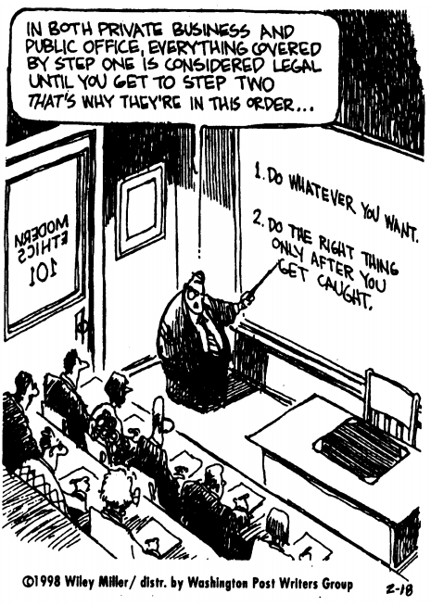
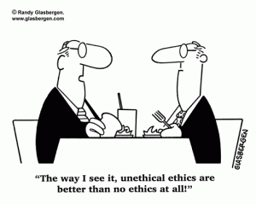
From http://www.online-writing-jobs.com/
  Looking for a writer to write 2 essay papers 7-10 pages long for college ethics class. You can have 6 topics to choose from. Each paper pays $50.00. Send in details of your experience in writing college papers and your grades for them. When you inquire I will send you the topics you have to choose from. Must be able to accept payment through pay pal.
  Email to ***@yahoo.com

Slide 3
A. What are “Ethics”
Paraphrasing Justice Stewart from Jacobellis v. Ohio, 378 U.S. 184 (1964), his honor is credited with
“I can’t define pornography, but I know it when I see it.”
Ethics is similar:
  Not so easy to define but we all have a pretty good idea when someone behaves unethically

Slide 4
A. What are “Ethics”
Merriam-Webster’s online dictionary Ethics definition:
  1. the discipline dealing with what is good and bad and with moral duty and obligation
  2 a: a set of moral principles : a theory or system of moral values ...
  b: the principles of conduct governing an individual or a group
  c : a guiding philosophy
  d : a consciousness of moral importance
  3. a set of moral issues or aspects (as rightness)

Slide 5
A. What are “Ethics”
Merriam-Webster’s online dictionary Ethics definition:
  1. the discipline dealing with what is good and bad and with moral duty and obligation
  2 a: a set of moral principles : a theory or system of moral values ...
  b: the principles of conduct governing an individual or a group
  c : a guiding philosophy
  d : a consciousness of moral importance
  3. a set of moral issues or aspects (as rightness)

Slide 6
B. Values, Morals, Laws
Values
  Personal beliefs in which there is emotional investment.
Punctuality
Responsibility
Obligation
Integrity
Self-Respect
Character
Accountability
Honesty
Virtue
Courage
A job well done is its own reward

Slide 7


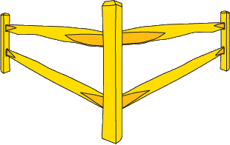

B. Values, Morals, Laws
Morals
  Rules which guide decisions about how to achieve value(s) on a given task.
    Task: Run your first marathon.
    Value: Satisfaction of completion
    Moral framework: Run entire circuit vs taking a shortcut
    Task: Re-est PLS corner
    Value: Sufficient for purpose at hand (Point of Commencement),
    Ensure future location certainty (perpetuation)
    Morale framework: degree of evidence research?
Notes:
Morals are internalized principles that form a framework for reasoning and decision making.
Ethics are the process of putting morals into action.
Legal issues are independent of morals and ethics.
Laws are created by societies (or at least for the governing of societies) but cannot “impose” morals upon individuals.
Laws may be created according to ethical guidelines
What is legal may not be ethical, as well the opposite—these are the gray areas and are often called “dilemmas.”
Examples--
Illegal but ethical: Late at night, a man has a heart attack on a nearly empty street while walking to his car with his teenaged son. His son calls 911 from a cell phone and then breaks into a closed Rite-Aid and grabs a package of aspirin and gives his father two tablets in hopes is will help until the paramedics arrive.
Legal but unethical: Creating and posting on the Internet (make available for download) a malicious computer virus with a damaging payload (and explicit instructions for implementation and launching of such a virus)—”free-speech” under the First Amendment.

Slide 8



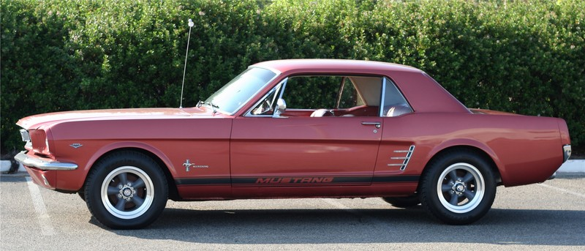

B. Values, Morals, Laws
Morals
  Rules which guide decisions about how to achieve value(s) on a given task.
    Flexible morale framework?
      Willing to bend or change the rules depending on situation?
Notes:
Morals are internalized principles that form a framework for reasoning and decision making.
Ethics are the process of putting morals into action.
Legal issues are independent of morals and ethics.
Laws are created by societies (or at least for the governing of societies) but cannot “impose” morals upon individuals.
Laws may be created according to ethical guidelines
What is legal may not be ethical, as well the opposite—these are the gray areas and are often called “dilemmas.”
Examples--
Illegal but ethical: Late at night, a man has a heart attack on a nearly empty street while walking to his car with his teenaged son. His son calls 911 from a cell phone and then breaks into a closed Rite-Aid and grabs a package of aspirin and gives his father two tablets in hopes is will help until the paramedics arrive.
Legal but unethical: Creating and posting on the Internet (make available for download) a malicious computer virus with a damaging payload (and explicit instructions for implementation and launching of such a virus)—”free-speech” under the First Amendment.

Slide 9



B. Values, Morals, Laws
Morals
  Rules which guide decisions about how to achieve value(s) on a given task.
    Flexible morale framework?
      Willing to bend or change the rules depending on situation?
I’d like to say thanks for the help by giving you a ...
Inspector
Contractor
Notes:
Morals are internalized principles that form a framework for reasoning and decision making.
Ethics are the process of putting morals into action.
Legal issues are independent of morals and ethics.
Laws are created by societies (or at least for the governing of societies) but cannot “impose” morals upon individuals.
Laws may be created according to ethical guidelines
What is legal may not be ethical, as well the opposite—these are the gray areas and are often called “dilemmas.”
Examples--
Illegal but ethical: Late at night, a man has a heart attack on a nearly empty street while walking to his car with his teenaged son. His son calls 911 from a cell phone and then breaks into a closed Rite-Aid and grabs a package of aspirin and gives his father two tablets in hopes is will help until the paramedics arrive.
Legal but unethical: Creating and posting on the Internet (make available for download) a malicious computer virus with a damaging payload (and explicit instructions for implementation and launching of such a virus)—”free-speech” under the First Amendment.

Slide 10


B. Values, Morals, Laws
Morals
  Rules which guide decisions about how to achieve value(s) on a given task.
    Flexible morale framework?
      Willing to bend or change the rules depending on situation?
... company pen and hat.
Whiz-Dump
Construction
Whiz-Dump Construction
Inspector
Contractor
Notes:
Morals are internalized principles that form a framework for reasoning and decision making.
Ethics are the process of putting morals into action.
Legal issues are independent of morals and ethics.
Laws are created by societies (or at least for the governing of societies) but cannot “impose” morals upon individuals.
Laws may be created according to ethical guidelines
What is legal may not be ethical, as well the opposite—these are the gray areas and are often called “dilemmas.”
Examples--
Illegal but ethical: Late at night, a man has a heart attack on a nearly empty street while walking to his car with his teenaged son. His son calls 911 from a cell phone and then breaks into a closed Rite-Aid and grabs a package of aspirin and gives his father two tablets in hopes is will help until the paramedics arrive.
Legal but unethical: Creating and posting on the Internet (make available for download) a malicious computer virus with a damaging payload (and explicit instructions for implementation and launching of such a virus)—”free-speech” under the First Amendment.

Slide 11
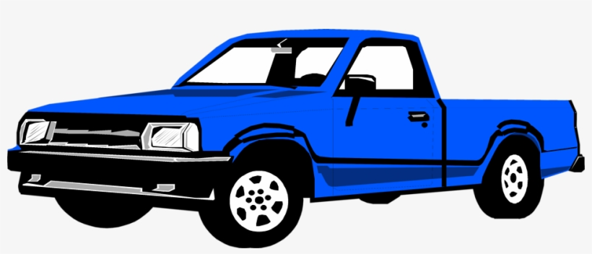
B. Values, Morals, Laws
Morals
  Rules which guide decisions about how to achieve value(s) on a given task.
    Flexible morale framework?
      Willing to bend or change the rules depending on situation?
... new pickup truck.
Inspector
Contractor
Notes:
Morals are internalized principles that form a framework for reasoning and decision making.
Ethics are the process of putting morals into action.
Legal issues are independent of morals and ethics.
Laws are created by societies (or at least for the governing of societies) but cannot “impose” morals upon individuals.
Laws may be created according to ethical guidelines
What is legal may not be ethical, as well the opposite—these are the gray areas and are often called “dilemmas.”
Examples--
Illegal but ethical: Late at night, a man has a heart attack on a nearly empty street while walking to his car with his teenaged son. His son calls 911 from a cell phone and then breaks into a closed Rite-Aid and grabs a package of aspirin and gives his father two tablets in hopes is will help until the paramedics arrive.
Legal but unethical: Creating and posting on the Internet (make available for download) a malicious computer virus with a damaging payload (and explicit instructions for implementation and launching of such a virus)—”free-speech” under the First Amendment.

Slide 12


B. Values, Morals, Laws
Morals
  Rules which guide decisions about how to achieve value(s) on a given task.
    Can there be a tipping point?
Morals
Right
Wrong
Whiz-Dump
Construction
Whiz-Dump Construction
Morals
Notes:
Morals are internalized principles that form a framework for reasoning and decision making.
Ethics are the process of putting morals into action.
Legal issues are independent of morals and ethics.
Laws are created by societies (or at least for the governing of societies) but cannot “impose” morals upon individuals.
Laws may be created according to ethical guidelines
What is legal may not be ethical, as well the opposite—these are the gray areas and are often called “dilemmas.”
Examples--
Illegal but ethical: Late at night, a man has a heart attack on a nearly empty street while walking to his car with his teenaged son. His son calls 911 from a cell phone and then breaks into a closed Rite-Aid and grabs a package of aspirin and gives his father two tablets in hopes is will help until the paramedics arrive.
Legal but unethical: Creating and posting on the Internet (make available for download) a malicious computer virus with a damaging payload (and explicit instructions for implementation and launching of such a virus)—”free-speech” under the First Amendment.

Slide 13
B. Values, Morals, Laws
Law
  Rules of conduct formally adopted & enforced by a group.
    Reflect group’s Values and Morals
    Binding on group members
    Group may be:
      Society - ordinances, statutes, code, etc
      Company - corporate policy
  Violation penalized by group
    Financial, loss or restriction of personal rights, job loss.
Notes:
Morals are internalized principles that form a framework for reasoning and decision making.
Ethics are the process of putting morals into action.
Legal issues are independent of morals and ethics.
Laws are created by societies (or at least for the governing of societies) but cannot “impose” morals upon individuals.
Laws may be created according to ethical guidelines
What is legal may not be ethical, as well the opposite—these are the gray areas and are often called “dilemmas.”
Examples--
Illegal but ethical: Late at night, a man has a heart attack on a nearly empty street while walking to his car with his teenaged son. His son calls 911 from a cell phone and then breaks into a closed Rite-Aid and grabs a package of aspirin and gives his father two tablets in hopes is will help until the paramedics arrive.
Legal but unethical: Creating and posting on the Internet (make available for download) a malicious computer virus with a damaging payload (and explicit instructions for implementation and launching of such a virus)—”free-speech” under the First Amendment.

Slide 14
B. Values, Morals, Laws
Ethics
  Basically: Systematized moral principles framework for making decisions where values conflict.
  Standard of right or wrong proscribing how we interact with others.
    Our values are involved as are theirs.
  Our “first” ethical code?
    Kindergarten/First Grade
      1. Don’t hurt anyone
      2. Tell the truth
      3. Respect your parents and teachers
Notes:
Morals are internalized principles that form a framework for reasoning and decision making.
Ethics are the process of putting morals into action.
Legal issues are independent of morals and ethics.
Laws are created by societies (or at least for the governing of societies) but cannot “impose” morals upon individuals.
Laws may be created according to ethical guidelines
What is legal may not be ethical, as well the opposite—these are the gray areas and are often called “dilemmas.”
Examples--
Illegal but ethical: Late at night, a man has a heart attack on a nearly empty street while walking to his car with his teenaged son. His son calls 911 from a cell phone and then breaks into a closed Rite-Aid and grabs a package of aspirin and gives his father two tablets in hopes is will help until the paramedics arrive.
Legal but unethical: Creating and posting on the Internet (make available for download) a malicious computer virus with a damaging payload (and explicit instructions for implementation and launching of such a virus)—”free-speech” under the First Amendment.

Slide 15
B. Values, Morals, Laws
Ethics
  A “perfect” Ethical Code: impartial and universal.
    Uniform application regardless of situation.
Situation 1
Ethical
Unethical
Situation 2
Ethical
Unethical
Uniform Ethical Application
Notes:
Morals are internalized principles that form a framework for reasoning and decision making.
Ethics are the process of putting morals into action.
Legal issues are independent of morals and ethics.
Laws are created by societies (or at least for the governing of societies) but cannot “impose” morals upon individuals.
Laws may be created according to ethical guidelines
What is legal may not be ethical, as well the opposite—these are the gray areas and are often called “dilemmas.”
Examples--
Illegal but ethical: Late at night, a man has a heart attack on a nearly empty street while walking to his car with his teenaged son. His son calls 911 from a cell phone and then breaks into a closed Rite-Aid and grabs a package of aspirin and gives his father two tablets in hopes is will help until the paramedics arrive.
Legal but unethical: Creating and posting on the Internet (make available for download) a malicious computer virus with a damaging payload (and explicit instructions for implementation and launching of such a virus)—”free-speech” under the First Amendment.

Slide 16
B. Values, Morals, Laws
Ethics
  “Perfect” not possible because of conflicting values:
    Differing situations may change value priorities.
    Valuation is dependent on perspective
    Is there a tipping point/area?
Gray Area
Situations
Tipping
Point?
Extreme
Extreme
Uniform Ethical Application?
Notes:
Morals are internalized principles that form a framework for reasoning and decision making.
Ethics are the process of putting morals into action.
Legal issues are independent of morals and ethics.
Laws are created by societies (or at least for the governing of societies) but cannot “impose” morals upon individuals.
Laws may be created according to ethical guidelines
What is legal may not be ethical, as well the opposite—these are the gray areas and are often called “dilemmas.”
Examples--
Illegal but ethical: Late at night, a man has a heart attack on a nearly empty street while walking to his car with his teenaged son. His son calls 911 from a cell phone and then breaks into a closed Rite-Aid and grabs a package of aspirin and gives his father two tablets in hopes is will help until the paramedics arrive.
Legal but unethical: Creating and posting on the Internet (make available for download) a malicious computer virus with a damaging payload (and explicit instructions for implementation and launching of such a virus)—”free-speech” under the First Amendment.

Slide 17
B. Values, Morals, Laws
Ethics
  Society frowns on people killing other people.
  We can all agree that random killing is unethical.
Ethical
Unethical
Don’t Kill
Kill
Uniform Ethical Application?
Notes:
Morals are internalized principles that form a framework for reasoning and decision making.
Ethics are the process of putting morals into action.
Legal issues are independent of morals and ethics.
Laws are created by societies (or at least for the governing of societies) but cannot “impose” morals upon individuals.
Laws may be created according to ethical guidelines
What is legal may not be ethical, as well the opposite—these are the gray areas and are often called “dilemmas.”
Examples--
Illegal but ethical: Late at night, a man has a heart attack on a nearly empty street while walking to his car with his teenaged son. His son calls 911 from a cell phone and then breaks into a closed Rite-Aid and grabs a package of aspirin and gives his father two tablets in hopes is will help until the paramedics arrive.
Legal but unethical: Creating and posting on the Internet (make available for download) a malicious computer virus with a damaging payload (and explicit instructions for implementation and launching of such a virus)—”free-speech” under the First Amendment.

Slide 18
B. Values, Morals, Laws
Ethics
  What if killing:
  Accidental?
  Castle doctrine?
  Self-defense?
Tipping Points?
Tipping point
Don’t Kill
Kill
Uniform Ethical Application?
Notes:
Morals are internalized principles that form a framework for reasoning and decision making.
Ethics are the process of putting morals into action.
Legal issues are independent of morals and ethics.
Laws are created by societies (or at least for the governing of societies) but cannot “impose” morals upon individuals.
Laws may be created according to ethical guidelines
What is legal may not be ethical, as well the opposite—these are the gray areas and are often called “dilemmas.”
Examples--
Illegal but ethical: Late at night, a man has a heart attack on a nearly empty street while walking to his car with his teenaged son. His son calls 911 from a cell phone and then breaks into a closed Rite-Aid and grabs a package of aspirin and gives his father two tablets in hopes is will help until the paramedics arrive.
Legal but unethical: Creating and posting on the Internet (make available for download) a malicious computer virus with a damaging payload (and explicit instructions for implementation and launching of such a virus)—”free-speech” under the First Amendment.

Slide 19
C. Laws and Ethics
Can we base Ethics on Laws?
  Laws:
    Structured and known
    Address societal concerns
    Define penalties
  Society members have responsibility to
    know,
    understand, and,
    obey.
      Ignorance of the law is no excuse.
Notes:
Morals are internalized principles that form a framework for reasoning and decision making.
Ethics are the process of putting morals into action.
Legal issues are independent of morals and ethics.
Laws are created by societies (or at least for the governing of societies) but cannot “impose” morals upon individuals.
Laws may be created according to ethical guidelines
What is legal may not be ethical, as well the opposite—these are the gray areas and are often called “dilemmas.”
Examples--
Illegal but ethical: Late at night, a man has a heart attack on a nearly empty street while walking to his car with his teenaged son. His son calls 911 from a cell phone and then breaks into a closed Rite-Aid and grabs a package of aspirin and gives his father two tablets in hopes is will help until the paramedics arrive.
Legal but unethical: Creating and posting on the Internet (make available for download) a malicious computer virus with a damaging payload (and explicit instructions for implementation and launching of such a virus)—”free-speech” under the First Amendment.

Slide 20



C. Laws and Ethics
While camping, my wife has a stroke.
  I put her into the car and drive as fast as I can to a hospital emergency room 15 miles away.
  I exceed speed limit by considerable amounts.
  Police cruiser picks me up on radar and begins pursuit.
  I ignore it and keep speeding for the hospital.
Notes:
Morals are internalized principles that form a framework for reasoning and decision making.
Ethics are the process of putting morals into action.
Legal issues are independent of morals and ethics.
Laws are created by societies (or at least for the governing of societies) but cannot “impose” morals upon individuals.
Laws may be created according to ethical guidelines
What is legal may not be ethical, as well the opposite—these are the gray areas and are often called “dilemmas.”
Examples--
Illegal but ethical: Late at night, a man has a heart attack on a nearly empty street while walking to his car with his teenaged son. His son calls 911 from a cell phone and then breaks into a closed Rite-Aid and grabs a package of aspirin and gives his father two tablets in hopes is will help until the paramedics arrive.
Legal but unethical: Creating and posting on the Internet (make available for download) a malicious computer virus with a damaging payload (and explicit instructions for implementation and launching of such a virus)—”free-speech” under the First Amendment.

Slide 21
C. Laws and Ethics
While camping, my wife has a stroke.
  I put her into the car and drive as fast as I can to a hospital emergency room 15 miles away.
  I exceed speed limit by considerable amounts.
  Police cruiser picks me up on radar and begins pursuit.
  I ignore it and keep speeding for the hospital.
Were my actions ethical?
Were my actions legal?
Notes:
Morals are internalized principles that form a framework for reasoning and decision making.
Ethics are the process of putting morals into action.
Legal issues are independent of morals and ethics.
Laws are created by societies (or at least for the governing of societies) but cannot “impose” morals upon individuals.
Laws may be created according to ethical guidelines
What is legal may not be ethical, as well the opposite—these are the gray areas and are often called “dilemmas.”
Examples--
Illegal but ethical: Late at night, a man has a heart attack on a nearly empty street while walking to his car with his teenaged son. His son calls 911 from a cell phone and then breaks into a closed Rite-Aid and grabs a package of aspirin and gives his father two tablets in hopes is will help until the paramedics arrive.
Legal but unethical: Creating and posting on the Internet (make available for download) a malicious computer virus with a damaging payload (and explicit instructions for implementation and launching of such a virus)—”free-speech” under the First Amendment.

Slide 22

C. Laws and Ethics
What if...
  ... I’d lost control of the car, hit another car, and kept going?
      Is a hit-and-run as forgivable as speeding?
  ... I’d lost control of the car, hit a pedestrian, and kept going?
  ... the ER determined my wife had heartburn?
  These didn’t happen until after I'd acted on my decision.
    Should I have anticipated them?
    Did I have time to consider these?
    Do I have control over any of these?
Notes:
Morals are internalized principles that form a framework for reasoning and decision making.
Ethics are the process of putting morals into action.
Legal issues are independent of morals and ethics.
Laws are created by societies (or at least for the governing of societies) but cannot “impose” morals upon individuals.
Laws may be created according to ethical guidelines
What is legal may not be ethical, as well the opposite—these are the gray areas and are often called “dilemmas.”
Examples--
Illegal but ethical: Late at night, a man has a heart attack on a nearly empty street while walking to his car with his teenaged son. His son calls 911 from a cell phone and then breaks into a closed Rite-Aid and grabs a package of aspirin and gives his father two tablets in hopes is will help until the paramedics arrive.
Legal but unethical: Creating and posting on the Internet (make available for download) a malicious computer virus with a damaging payload (and explicit instructions for implementation and launching of such a virus)—”free-speech” under the First Amendment.

Slide 23
C. Laws and Ethics
Any action is:
  legal or illegal ethical or unethical
Unethical
Illegal
Legal
Ethical
Notes:
Morals are internalized principles that form a framework for reasoning and decision making.
Ethics are the process of putting morals into action.
Legal issues are independent of morals and ethics.
Laws are created by societies (or at least for the governing of societies) but cannot “impose” morals upon individuals.
Laws may be created according to ethical guidelines
What is legal may not be ethical, as well the opposite—these are the gray areas and are often called “dilemmas.”
Examples--
Illegal but ethical: Late at night, a man has a heart attack on a nearly empty street while walking to his car with his teenaged son. His son calls 911 from a cell phone and then breaks into a closed Rite-Aid and grabs a package of aspirin and gives his father two tablets in hopes is will help until the paramedics arrive.
Legal but unethical: Creating and posting on the Internet (make available for download) a malicious computer virus with a damaging payload (and explicit instructions for implementation and launching of such a virus)—”free-speech” under the First Amendment.

Slide 24
C. Laws and Ethics
Any action is:
  legal or illegal ethical or unethical
Possible
consequences
Unethical
Illegal
Legal
Ethical
Unethical
Illegal
Legal
Ethical
Notes:
Morals are internalized principles that form a framework for reasoning and decision making.
Ethics are the process of putting morals into action.
Legal issues are independent of morals and ethics.
Laws are created by societies (or at least for the governing of societies) but cannot “impose” morals upon individuals.
Laws may be created according to ethical guidelines
What is legal may not be ethical, as well the opposite—these are the gray areas and are often called “dilemmas.”
Examples--
Illegal but ethical: Late at night, a man has a heart attack on a nearly empty street while walking to his car with his teenaged son. His son calls 911 from a cell phone and then breaks into a closed Rite-Aid and grabs a package of aspirin and gives his father two tablets in hopes is will help until the paramedics arrive.
Legal but unethical: Creating and posting on the Internet (make available for download) a malicious computer virus with a damaging payload (and explicit instructions for implementation and launching of such a virus)—”free-speech” under the First Amendment.

Slide 25
C. Laws and Ethics
Any action is:
  legal or illegal ethical or unethical
Possible
consequences
Unethical and legal | Unethical and illegal
Ethical and legal | Ethical and illegal
Unethical
Illegal
Legal
Ethical
Notes:
Morals are internalized principles that form a framework for reasoning and decision making.
Ethics are the process of putting morals into action.
Legal issues are independent of morals and ethics.
Laws are created by societies (or at least for the governing of societies) but cannot “impose” morals upon individuals.
Laws may be created according to ethical guidelines
What is legal may not be ethical, as well the opposite—these are the gray areas and are often called “dilemmas.”
Examples--
Illegal but ethical: Late at night, a man has a heart attack on a nearly empty street while walking to his car with his teenaged son. His son calls 911 from a cell phone and then breaks into a closed Rite-Aid and grabs a package of aspirin and gives his father two tablets in hopes is will help until the paramedics arrive.
Legal but unethical: Creating and posting on the Internet (make available for download) a malicious computer virus with a damaging payload (and explicit instructions for implementation and launching of such a virus)—”free-speech” under the First Amendment.

Slide 26
C. Laws and Ethics
Not everyone has the same ethical perspective.
But we’re all subject to the same laws
Unethical
Unethical
Unethical
Ethical
Ethical
Ethical
Legal
Illegal
Legal
Illegal
Legal
Illegal
Notes:
Morals are internalized principles that form a framework for reasoning and decision making.
Ethics are the process of putting morals into action.
Legal issues are independent of morals and ethics.
Laws are created by societies (or at least for the governing of societies) but cannot “impose” morals upon individuals.
Laws may be created according to ethical guidelines
What is legal may not be ethical, as well the opposite—these are the gray areas and are often called “dilemmas.”
Examples--
Illegal but ethical: Late at night, a man has a heart attack on a nearly empty street while walking to his car with his teenaged son. His son calls 911 from a cell phone and then breaks into a closed Rite-Aid and grabs a package of aspirin and gives his father two tablets in hopes is will help until the paramedics arrive.
Legal but unethical: Creating and posting on the Internet (make available for download) a malicious computer virus with a damaging payload (and explicit instructions for implementation and launching of such a virus)—”free-speech” under the First Amendment.

Slide 27
C. Laws and Ethics
Not everyone has the same ethical perspective.
    The legality of an act may be clear
Unethical
Unethical
Unethical
Ethical
Ethical
Ethical
Legal
Illegal
Legal
Illegal
Legal
Illegal
Notes:
Morals are internalized principles that form a framework for reasoning and decision making.
Ethics are the process of putting morals into action.
Legal issues are independent of morals and ethics.
Laws are created by societies (or at least for the governing of societies) but cannot “impose” morals upon individuals.
Laws may be created according to ethical guidelines
What is legal may not be ethical, as well the opposite—these are the gray areas and are often called “dilemmas.”
Examples--
Illegal but ethical: Late at night, a man has a heart attack on a nearly empty street while walking to his car with his teenaged son. His son calls 911 from a cell phone and then breaks into a closed Rite-Aid and grabs a package of aspirin and gives his father two tablets in hopes is will help until the paramedics arrive.
Legal but unethical: Creating and posting on the Internet (make available for download) a malicious computer virus with a damaging payload (and explicit instructions for implementation and launching of such a virus)—”free-speech” under the First Amendment.

Slide 28
C. Laws and Ethics
Not everyone has the same ethical perspective.
    But its ethical implication can differ based on individual values.
Unethical
Unethical
Legal
Illegal
Legal
Illegal
Legal
Illegal
Unethical
Ethical
Ethical
Ethical
Ethical
Unethical
Fuzzy
Notes:
Morals are internalized principles that form a framework for reasoning and decision making.
Ethics are the process of putting morals into action.
Legal issues are independent of morals and ethics.
Laws are created by societies (or at least for the governing of societies) but cannot “impose” morals upon individuals.
Laws may be created according to ethical guidelines
What is legal may not be ethical, as well the opposite—these are the gray areas and are often called “dilemmas.”
Examples--
Illegal but ethical: Late at night, a man has a heart attack on a nearly empty street while walking to his car with his teenaged son. His son calls 911 from a cell phone and then breaks into a closed Rite-Aid and grabs a package of aspirin and gives his father two tablets in hopes is will help until the paramedics arrive.
Legal but unethical: Creating and posting on the Internet (make available for download) a malicious computer virus with a damaging payload (and explicit instructions for implementation and launching of such a virus)—”free-speech” under the First Amendment.

Slide 29
C. Laws and Ethics
Laws and Ethics
  Symbiotic relationship
    Related; concern the same actions
  Proportions of Legal/Illegal, Ethical/Unethical change over time.
    Beliefs, values, etc, change
    Evolution, maturation
  Fuzzy boundaries:
  Distinction: Laws involve compliance; Ethics involve choice.
Unethical
Tipping points?
Ethical
Notes:
Morals are internalized principles that form a framework for reasoning and decision making.
Ethics are the process of putting morals into action.
Legal issues are independent of morals and ethics.
Laws are created by societies (or at least for the governing of societies) but cannot “impose” morals upon individuals.
Laws may be created according to ethical guidelines
What is legal may not be ethical, as well the opposite—these are the gray areas and are often called “dilemmas.”
Examples--
Illegal but ethical: Late at night, a man has a heart attack on a nearly empty street while walking to his car with his teenaged son. His son calls 911 from a cell phone and then breaks into a closed Rite-Aid and grabs a package of aspirin and gives his father two tablets in hopes is will help until the paramedics arrive.
Legal but unethical: Creating and posting on the Internet (make available for download) a malicious computer virus with a damaging payload (and explicit instructions for implementation and launching of such a virus)—”free-speech” under the First Amendment.

Slide 30
C. Laws and Ethics
Laws and Ethics
  Symbiotic relationship
    Related; concern the same actions
  Proportions of Legal/Illegal, Ethical/Unethical change over time.
    Beliefs, values, etc, change
    Evolution, maturation
  Fuzzy boundaries:
  Distinction: Laws involve compliance; Ethics involve choice.
So far we’ve looked at
Personal ethics.
What about Professional ethics?
Unethical
Tipping points?
Ethical
Notes:
Morals are internalized principles that form a framework for reasoning and decision making.
Ethics are the process of putting morals into action.
Legal issues are independent of morals and ethics.
Laws are created by societies (or at least for the governing of societies) but cannot “impose” morals upon individuals.
Laws may be created according to ethical guidelines
What is legal may not be ethical, as well the opposite—these are the gray areas and are often called “dilemmas.”
Examples--
Illegal but ethical: Late at night, a man has a heart attack on a nearly empty street while walking to his car with his teenaged son. His son calls 911 from a cell phone and then breaks into a closed Rite-Aid and grabs a package of aspirin and gives his father two tablets in hopes is will help until the paramedics arrive.
Legal but unethical: Creating and posting on the Internet (make available for download) a malicious computer virus with a damaging payload (and explicit instructions for implementation and launching of such a virus)—”free-speech” under the First Amendment.

Slide 31



D. Professional Ethics?
1. Profession
  Individuals who share specialized skill & knowledge.
  Has a set of values which help maintain integrity of that profession.
  Who’s in charge of a profession?
    Generally only authority is a licensing one
    Usually gov’t based, therefore define things in law.
    Affect all licensed professionals.

Slide 32

D. Professional Ethics?
2. Professional Organization
  Individuals grouped together to represent and advance their profession.
  Organization:
    Provides growth framework for the profession and individuals.
    Maintains integrity
      One way: develop an Ethical Code
        Identify value areas and provide guidance.
      Policing body - Ethics or Standards of Practice
      Affect only members
        Revocation of membership or certification

Slide 33
D. Professional Ethics?
3. Land Surveying
    Boundary creation and establishment dependent on
      Written law
      Common law
    Decisions and actions are based on a legal framework.
    a. Statutory regulation
      Inevitably, actions and responsibilities may also be legally “regulated.”
      Many states have law/admin code for:
        (1) Minimum Standards
        (2) Professional conduct/Ethical Responsibilities

Slide 34
D. Professional Ethics?
3. Land Surveying
    a. Statutory regulation
      (1) Minimum Standards
      Why? A subject for another discussion
      Basically: - Boundary creation covered by statute law, resurvey by common law.
        Statute law: details layout standards, mapping requirements, accuracies, etc.
        Common law: does not; “what a competent surveyor would do”
      Minimum standards provide
        Resurvey technical specifications
        Safety net if a particular boundary creation method is not statutorily addressed
          Example: In Wis - Cemetery Plats

Slide 35
D. Professional Ethics?
3. Land Surveying
    a. Statutory regulation
      (1) Minimum Standards
      Example: Wis Admin Code A-E 7
          A-E 7.01 Scope
          A-E 7.02 Definitions.
          A-E 7.025 Survey report, requirements
          A-E 7.03 Boundary Location
          A-E 7.04 Descriptions
          A-E 7.05 Maps
          A-E 7.06 Relative positional accuracy measurements
          A-E 7.07 Monuments
          A-E 7.08 U.S. public land survey monument record

Slide 36
D. Professional Ethics?
3. Land Surveying
    a. Statutory regulation
      (1) Minimum Standards
      Emphasis on professional judgment for resurveys
        A-E 7.03(1) “Every property survey shall be made in accordance with the records of the register of deeds as nearly as practicable.”
        A-E 7.06(1) “Measurements shall be made with instruments and methods capable of attaining the relative positional accuracy in accordance with this section.”

Slide 37
D. Professional Ethics?
3. Land Surveying
    a. Statutory regulation
      (2) Professional Conduct
        Wis Admin Code A-E 8 Professional Conduct
          A-E 8.01 Authority.
          A-E 8.02 Intent.
          A-E 8.03 Definitions.
          A-E 8.04 Offers to perform services shall be truthful.
          A-E 8.05 Conflicts of interest.
          A-E 8.06 Professional obligations
          A-E 8.07 Unauthorized practice.
          A-E 8.08 Maintenance of professional standards.
          A-E 8.09 Adherence to statutes and rules.
          A-E 8.10 Plan stamping.
          A-E 8.11 Suspension of registration; effect.

Slide 38
D. Professional Ethics?
3. Land Surveying
    a. Statutory regulation
      (2) Professional Conduct
      A-E 8.02 Intent:
        The intent of the examining board in adopting this chapter is to establish rules of professional conduct for the professions of architecture, landscape architecture, professional engineering, designing and professional land surveying. A violation of any standard specified in this chapter may result in disciplinary action under ss. 443.11 to 443.13, Stats.
      Wis Stat Sec 443.12 Disciplinary proceedings against professional land surveyors:
        (1) The professional land surveyor section may reprimand a professional land surveyor, or limit, suspend, or revoke the license of any professional land surveyor, for the practice of any fraud or deceit in obtaining the license, or any gross negligence, incompetence, or misconduct in the practice of professional land surveying.

Slide 39


D. Professional Ethics?
3. Land Surveying
    b. Professional Organization
      (1) National Level
        NSPS Surveyor’s Creed and Canons
Canon 1. | A Professional Surveyor should refrain from conduct that is detrimental to the public.
Canon 2. | A Professional Surveyor should abide by the rules and regulations pertaining to the practice of surveying within the licensing jurisdiction.
Canon 3. | A Professional Surveyor should accept assignments only in one's area of professional competence and expertise.
Canon 4. | A Professional Surveyor should develop and communicate a professional analysis and opinion without bias or personal interest.
Canon 5. | A Professional Surveyor should maintain the confidential nature of the surveyor-client relationship.
Canon 6. | A Professional Surveyor should use care to avoid advertising or solicitation that is misleading otherwise contrary to the public interest.
Canon 7. | A Professional Surveyor should maintain professional integrity when dealing with members of other professions.

Slide 40

D. Professional Ethics?
3. Land Surveying
    b. Professional Organization
      (2) State Level
      State Surveying Associations
        Limited sampling:
          Most NSPS-affiliated used NSPS Creeds and Canons
          Not many have their own codes
          Those that do tend to have (hide?) them in members-only areas

Slide 41
D. Professional Ethics?
3. Land Surveying
    b. Professional Organization
      (2) State Level
      Advantages of a published Code?
      Disadvantages of a published Code?

Slide 42


Summary
What does it boil down to?
1. Don’t hurt anyone
2. Tell the truth
3. Respect others

Slide 43

E. Case Studies
Consider:
  Is there an ethical dilemma?
  Does the Surveyor’s Creed and Canons and/or your state society’s ethical code provide sufficient guidance?
  If...
    1 ... no dilemma, is there a tipping point which would make it one?
    2 ... a dilemma, can something be changed?

Slide 44
E. Case Studies
Consider:
  Is there a legal element which affects your decision?
  If ethics are involved - personal or professional?
  What other parties might be affected and how?
  Other factors which could change your ethical stance?
  What happens if ethical perspectives clash?

Slide 45

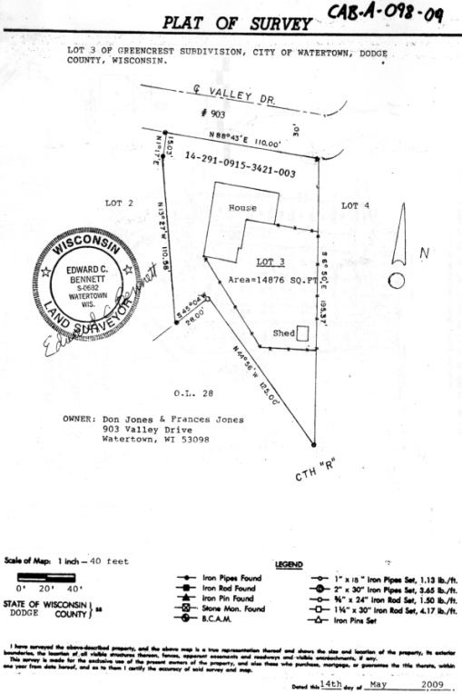
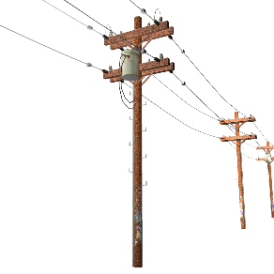
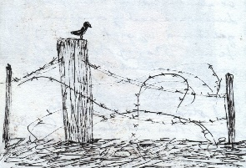
F. Case Studies
Case Study 1
  The phone call offering a class project
Case Study 2
  Delayed map filing
Case Study 3
  Easement not on map
Case Study 4
  Fence corner

Slide 46


