Slide 1
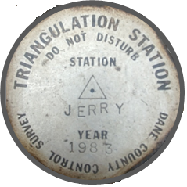
Mentoring Mondays, 13 Sep 2021 Conflicting Title Elements: Rules of Construction
Jerry Mahun, PLS
jerrymahun.com
Home | Mentoring Mondays | Rules of Construction
password: monday_roc
Typos in original Powerpoint. Corrected version uploaded Mon 13 Sep 10:00 am CDT

Slide 2
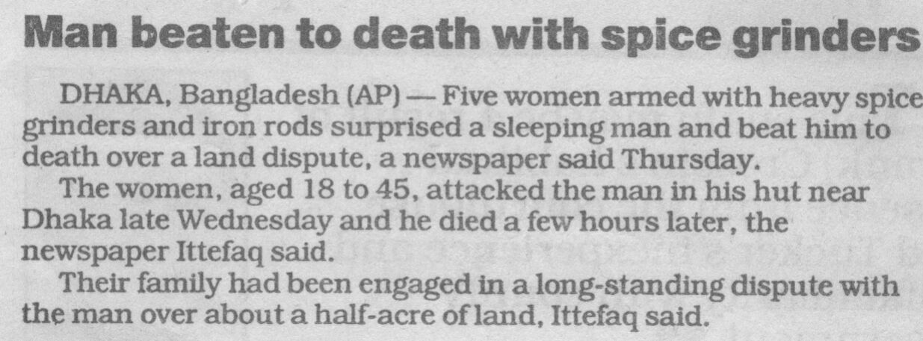
The original Spice Girls?

Slide 3
Learning Objectives
How parcels and boundaries are created
Where the Rules of Construction come from
What are unwritten rights
How gaps and overlaps are handled
The Statute of Frauds and why it matters
Description interpretation issues: Ambiguities; Controlling/informative terms
Written intent conflicts

Slide 4
Just enough to be dangerous...
A ~40 slide Powerpoint doesn’t make you a description interpretation expert.
This material is a general overview with a lot of caveats because it is based on common law.
Common law can vary between jurisdictions; must be familiar with your area.
Often there is no definitive solution to a re-establishment problem, only the “best” given the circumstances.
Changing evidence even a little can dramatically affect the conclusion.
Research is key, including a title search back to parcel beginnings and parol evidence.
Consider all reasonable alternatives and why they do or don’t apply.

Slide 5
I. Parcel Creation
A. What, Why?
Parent-Child
At least one new boundary
Possible shared boundaries
Multiple children, multiple new boundaries – how do they relate?
Family analogy
Child inherits characteristics from parent
Parent must provide for child
Child
D
Child
C
Parent
Parent
Child
A
Child
A
Child
B

Slide 6
I. Parcel Creation
B. Processes
How boundaries are created affect:
Description type
How are gaps and overlaps handled
Boundary creation
Establishes boundary once and forever.
Creates adjoiner relationship
Location is “without error.”
Creates evidence framework for later re-establishment.
Creation methods
Simultaneous
Sequential
Combination

Slide 7
I. Parcel Creation
B. Processes
1. Simultaneous
Boundaries created at the same time by the same legal instrument. Have equal standing - no Sr-Jr relationships.
Lot 4
Lot 3
Description types
Lot and block
Aliquot part
Lot 5
Lot 2
Lot 6
Lot 1
Section

Slide 8
I. Parcel Creation
B. Processes
2. Sequential
New parcels created independently from same parent over time.
Earlier created boundaries have precedence (senior) over later created ones (junior).
Parent
Parcel
Parcel 3
2015
Parcel 1
2008
Description types
Metes
Bounds
Metes and Bounds
Jr
Sr
Jr Jr
Sr Sr
Parcel 2
2010

Slide 9
I. Parcel Creation
B. Processes
3. Combination
New parcels created by combination of simultaneous and sequential processes.
New boundaries can have characteristics of either or both.
Senior-junior standing may or may not exist
Description type
Quasi-metes and bounds;
“of”
Lot 3
Lot 2
Lot 1
Lot 3
Lot 2
Lot 1
Lot 4
Lot 5
Lot 6
Lot 4
Lot 5
Lot 6
New parcel is part of Lot 4
and part of Lot 5

Slide 10
II. Rules of Construction (RoC)
Evaluation framework (aka Order of Importance of Conflicting Elements)
Right of possession (unwritten rights)
Senior right (in case of overlap)
Written intentions of the parties (description)
Call for survey
Call for monuments; adjoiner
Direction/distance
Area/Coordinates
If elements conflict, RoC indicates their relative weight
Not strict; guidelines
Description wording can change order
If higher elements are lost, lesser elements carry greater weight.
Particular
circumstances
Increasing weight
Written
Record

Slide 11
II. Rules of Construction (RoC)
A. Right of Possession: Unwritten Rights
Based on adjacent owners actions/inactions
Ownership departs from description
Doctrines
Adverse possession
Prescription
Oral agreement
Equitable estoppel
Recognition and acquiescence
Ownership determined by courts
Surveyor doesn’t have authority
Map deed and use (encroachment) lines
Fence
Deed
Line
Deed
Line
Ownership
Line
Unwritten
Right

Slide 12
II. Rules of Construction (RoC)
B. Senior Right: Gap or Overlap
Precedence establishment
Once boundary is created, Sr-Jr relationship is established and doesn’t change unless boundary is legally removed.
Is a boundary attribute, not an owner attribute
Child inherits parent’s Sr-Jr standing along shared boundaries.
Parent is junior to children – parent must provide.
≥2 adjoining children from common parent-
overlap/gap potential
Resolution depends on how parcels are created
Child
B
Child
A
Parent

Slide 13
II. Rules of Construction (RoC)
B. Senior Right: Gap or Overlap
1. Simultaneous
Parcel boundaries have equal standing: no sr-jr rights
Excess or deficiency proportioned between found original corners
Subdivision
USPLS
Single or Double Proportionate Measurement
372.5 ft
Lot 1: W = (372.5/375.0) x 125.0 = 124.2 ft
Lot 2: W = (372.5/375.0) x 100.0 = 99.3 ft
Lot 3: W = (372.5/375.0) x 150.0 = 149.0 ft
✓ 372.5 ft
125.0 ft
100.0 ft
150.0 ft
Lot 1
Lot 2
Lot 3

Slide 14
II. Rules of Construction (RoC)
B. Senior Right: Gap or Overlap
2. Sequential
Earlier created boundaries have higher standing than later boundaries
Parent
Parcel
A:2008
Parent
Remainder
Jr
Sr
Parent
Remainder
A: 2008
C: 2015
A: 2008
Jr
Sr
Jr Jr
Sr Sr
Jr
Sr
Jr Jr
Sr Sr
B: 2010
B: 2010

Slide 15
II. Rules of Construction (RoC)
B. Senior Right: Gap or Overlap
2. Sequential
Child inherits parent’s sr-jr relationship along shared boundaries
C: 2015
A: 2008
C: 2015
A
Remainder
Jr
Sr
Jr Jr
Sr Sr
Jr
Sr
Jr Jr
Sr Sr
Jr
Sr
B: 2010
B: 2010
Sr
Jr
D: 2017
Inheritance
Parcel D description might call Parcel B as adjoiner but
Parcel D is senior by inheritance.

Slide 16
II. Rules of Construction (RoC)
B. Senior Right: Gap or Overlap
2. Sequential
Along sr-jr boundaries:
• Sr parcel protected in case of an overlap - the junior parcel yields.
• If excess, gap is parent remainder.
Touchy situation: Give to one parcel or other or split between?
Obviously original intent wasn’t for a gap to exist.
“The question is not what reasonable men intended to convey but what they in fact described in the contract or memorandum.”
Wiegand v. Gissal, 28 Wis. 2d 488, Wis. Supreme Court 1965
The gap was not conveyed.
A: 2010
Sr
Parent
Parent
Remainder
Jr
B: 2013

Slide 17
II. Rules of Construction (RoC)
B. Senior Right: Gap or Overlap
3. Combination
Parcel boundaries may or may not have sr-jr relationships
Example:
Subdivision: simultaneous, no sr-jr relationships
200.00’
200.00’
200.00’
Lot 11
Lot 12
Lot 13
200.00’
200.00’
200.00’

Slide 18
II. Rules of Construction (RoC)
B. Senior Right: Gap or Overlap
3. Combination
Parcel boundaries may or may not have sr-jr relationships
Example:
Sequentially: “West 100.0 ft of Lot 12” later “East 100.0 ft of Lot 12”
200.00’
200.00’
200.00’
W 100.0’
E 100.0’
Lot 11
Sr
Jr
Lot 13
200.00’
200.00’
200.00’
No sr-jr relationships
along these lines.

Slide 19
II. Rules of Construction (RoC)
B. Senior Right: Gap or Overlap
3. Combination
Parcel boundaries may or may not have sr-jr relationships
Example:
Sequentially: “West 100.0 ft of Lot 12” later “East 100.0 ft of Lot 12”
Resurvey: Deficiency on N, excess on S creates 2.0 ft remainder
198.0’
200.00’
200.00’
200.00’
100.0’
98.0’
W 100.0’
E 100.0’
Lot 11
W 100.0’
Sr
Jr
E 100.0’
Lot 13
Sr
Jr
200.00’
100.0’
100.0’
200.00’
202.0’
2.0’ Remainer

Slide 20
II. Rules of Construction (RoC)
B. Senior Right: Gap or Overlap
3. Combination
Parcel boundaries may or may not have sr-jr relationships
Example:
Instead: “West 100.0 ft of Lot 12” later “Lot 12 except West 100.0 ft”
200.00’
200.00’
200.00’
Lot 12
except
W 100.0’
W 100.0’
Lot 11
Lot 13
Sr
Jr
200.00’
200.00’
200.00’
No sr-jr relationships
along these lines.

Slide 21
II. Rules of Construction (RoC)
B. Senior Right: Gap or Overlap
3. Combination
Parcel boundaries may or may not have sr-jr relationships
Example:
Instead: “West 100.0 ft of Lot 12” later “East 100.0 ft of Lot 12”
Resurvey: Deficiency on N, excess on S to junior parcel
198.0’
200.00’
200.00’
200.00’
100.0’
98.0’
Lot 12
except
W 100.0’
W 100.0’
W 100.0’
E 100.0’
Lot 11
Sr
Jr
Lot 13
Sr
Jr
200.00’
100.0’
102.0’
200.00’
202.0’

Slide 22
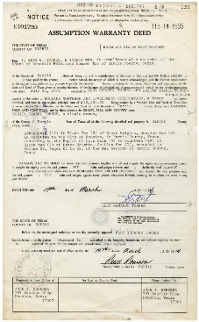
II. Rules of Construction (RoC)
C. Written Intent
1. Background
a. Statute of Frauds (SoF)
Contract must be in writing to be valid.
All terms included
Prevents contradiction by action or word
Interested third parties can interpret
Deed is a contract for property conveyance
Description defines physical extent and rights transferred
Written intent
What about unwritten rights?
Courts do not view unwritten rights as title transfer but instead as title clarification.

Slide 23
II. Rules of Construction (RoC)
C. Written Intent
1. Background
b. Description Interpretation
Simultaneous: references to map or plat
Unless errors on map, intent relatively clear
Sequential or Combination: narrative descriptions
Greater conflicts potential
Archaic terms, “ancient” measurements
“Commencing at a point 20 rods 19 links North of a point that is 26 links East of the East side of the steel tube at the Northeast corner of the wagon bridge...” (1992)
Written by non-surveyors
“Commencing at the West 1/4 corner of Section 9; thence N80° 29ft 17in. East, 2781.62 ft; thence S89° 11ft East, 177.84 ft;...” (1996)
Surveyor must follow common law principles to interpret & apply description

Slide 24
II. Rules of Construction (RoC)
C. Written Intent
1. Background
c. Controlling and Informative Terms
Controlling: defines course termination and/or path
Key words: to, along, parallel, perpendicular, with, continuing...
Identify a condition
Informative: all other terms, help identify controlling term(s)
“..thence North 38 degrees West 139.6 feet to an iron stake...”
Go to and end at the iron stake (to);
Monument higher element, dist & dir yield if conflict.
“...thence southwesterly along said high water mark to an iron stake...”
Course follows topographic feature (along)
and ends at an iron stake (to);

Slide 25
II. Rules of Construction (RoC)
C. Written Intent
1. Background
d. Ambiguities
(1) Extrinsic evidence
Physical and parol evidence outside the description.
Cannot be used to change description terms, only help explain.
(2) Ambiguity Types
Ambiguity: when something can be reasonably interpreted more than one way. Introduces confusion.
Common in descriptions written by non-surveyors.

Slide 26
II. Rules of Construction (RoC)
C. Written Intent
1. Background
d. Ambiguities
(2) Ambiguity Types
(a) Latent
Hidden, not apparent until application.
“Commencing at a point 84 1/4° East of the center of Section Seven (7); being station "A” having bearing tree viz; a black oak 14 inches in diameter, South 6° East 57 links distant, (said black oak being North 84 3/4° East, 24 7/25 rods of Stephen A. Thayer dwelling house),...” (1999)
May need extrinsic evidence to reconstruct location

Slide 27
II. Rules of Construction (RoC)
C. Written Intent
1. Background
d. Ambiguities
(2) Ambiguity Types
(a) Patent
Obvious, immediately apparent
“... thence S55° 55ft 20in West, 15.36 ft;"” (1999)
Mistake in original contract.
Mistake must be found and applied where it occurred.
Correction instrument

Slide 28
II. Rules of Construction (RoC)
C. Written Intent
2. Call for survey
Some boundary creations are based on survey and monumentation
USPLS: survey before sale
Subdivision plat: map and monument before sale
Survey & map are primary evidence of intent.
Typical for simultaneously created parcels.
3. Monuments and Corners
a. Monument v Corner
Corner: legal location; dimensionless
Monument: physical feature used to mark a corner
Monument is corner surrogate, if it controls

Slide 29
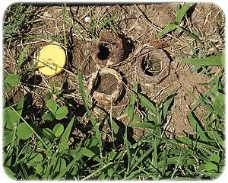
II. Rules of Construction (RoC)
C. Written Intent
3. Monuments and Corners
b. Monument
(1) To control over lesser elements
Must be
Called in description
Identifiable
Undisturbed
Can control
Direction and termination
Direction only; termination controlled by higher element
(2) Accessories
When established at original monument placement, are considered part of the monument.

Slide 30
II. Rules of Construction (RoC)
C. Written Intent
3. Monuments
b. Monument
(3) Disposition: Location certainty
Existent (Found): position can be identified by original mon/acc or acceptable physical & parol evidence. Location is certain.
Obliterated: no traces of original mon/acc, but position can be re-est beyond reasonable doubt using physical & parol evidence.
Lost: Insufficient evidence to re-est beyond reasonable doubt. Must resort to measurements to surrounding corners.

Slide 31
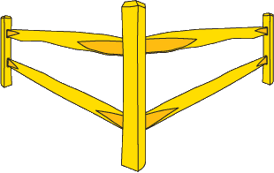
II. Rules of Construction (RoC)
C. Written Intent
3. Monuments
b. Monument
(4) Corner by Common Report
Location based on reputation
Reasonable location
Accepted by all affected parties
Location can’t be disproved
Avoid using this location justification. Based on unwritten rights.
Evidence collection and evaluation.

Slide 32
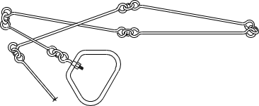
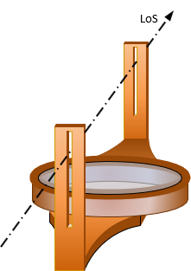
II. Rules of Construction (RoC)
C. Written Intent
4. Measurements
a. Distance and Direction
Inferior to a controlling monument
Control if:
Monuments not called
Called monuments are lost
Direction basis? Can recreate in field?
How numbers are written convey magnitude and implied accuracy.
“North, 200 ft”
How close to north? Distance to 100 ft, 10 ft, 1 ft?
“...thence S88°16’52”W, 0.30 feet to the existing east line of Section 1, T5N, R9E; thence S00°18’01”W, 0.01 feet along said east line of Section 1;...” (2002)

Slide 33
II. Rules of Construction (RoC)
C. Written Intent
4. Measurements
b. General directions
Informative term
A range of directions for each general one
N
Northerly
Northwesterly
Northeasterly
N 22.5° W
N 22.5° E
N 67.5° W
N 67.5° E
“...to the northerly sideline of Maple Drive; thence easterly along said sideline...”
Westerly
W
Easterly
E
S 67.5° W
S 67.5° E
S 22.5° W
S 22.5° E
Southwesterly
Southeasterly
Southerly
S

Slide 34
II. Rules of Construction (RoC)
C. Written Intent
4. Measurements
c. What’s a conflict?
Last two courses “... thence S18°20’W, 283.2 ft to a 1/2-inch iron pin; thence 220 ft back to the point of beginning.”
All corners have been recovered until last one before POB.
No mon evidence at S18°20’W, 283.2 ft, pt A.
1/2-inch iron pin at S17°50’10”W, 285.72 ft, p B.
A & B ~3 ft apart.
POB to pt A is 220.5 ft, to pt B 224.52 ft.
Are dist and dir to pt B “too far” from record dir and dist?
Can lower elements control over higher elements?
Does pt A fit closing line better than pt B?
Is B-POB dist within the uncertainty of the 220 ft call?
How much must elements differ to conflict with each other?
Extrinsic evidence?
A
B

Slide 35
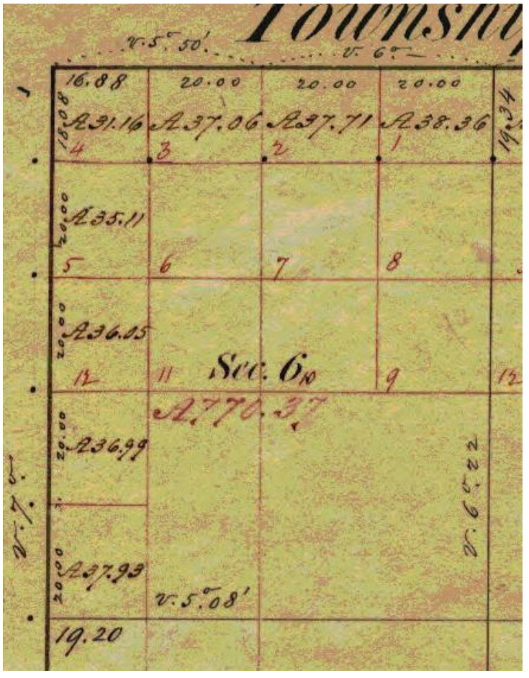
II. Rules of Construction (RoC)
C. Written Intent
5. Area/Coordinates
a. Area
USPLS: nominal or legal area. Actual area may be larger or smaller.
Subdiv laws: areas included on plat
Informative in both cases.
M&B descriptions
Area generally in summation
“...said parcel containing 1.5 acres.”
Informative
Controls if intent was to convey specific amount.
“...the Easterly 2 acres...”
“...the southeasterly half...”

Slide 36
II. Rules of Construction (RoC)
C. Written Intent
5. Area/Coordinates
b. Coordinates
Coordinates, even with GPS, are derived quantities.
Historically have either not been included or were informative.
Times changing’:
“...thence Northerly 487 feet, more or less, to GPS waypoint, Lat. 43.828655, Long. -90.661033; thence Northwesterly 296 feet, more or less, to GPS waypoint, Lat. 43.829424, Long. -90.661390; thence Westerly 298 feet more or less, to GPS waypoint, Lat. 43.829516, Long. -90.662515;...” (2005)
No higher element calls.
Controlling terms: to GPS waypoint
Coordinate questions
Units? Accuracy? Datum/adjustment?

Slide 37
II. Rules of Construction (RoC)
C. Written Intent
6. More or less
Indicates an element has unknown certainty.
The element is informative
Similar terms: approximately, plus minus, ±, about
“...thence running in an Easterly and Southeasterly direction along the South and Southwesterly line of private road that is used by the grantee herein a distance of about 28 rods; thence...” (2001)
Need extrinsic evidence
Go to the last Stop sign and take a left.
How do I know
it’s the last one?

Slide 38
II. Rules of Construction (RoC)
C. Written Intent
7. Conflicting Title Elements
“...Beginning at a 1-inch diameter iron bar in the north line of the Pohl property; thence N10°20’E 241 ft to a 1/2-inch iron pin; thence N85°35’E 267 ft to a 1/2-inch iron pin; thence S18°45’W 283 ft; thence back to the point of beginning”
First two courses found with no issues. Diagram shows third course situation.
How to run in last two courses?
Assume no extrinsic evidence available.
Pohl line
No monument found at S18°45’W 283 ft. This location is 1.3 ft south of Pohl’s line.
1/2-inch iron pin found at S17°50’36”W 282.91 ft. Pin is 2.0 ft south of Pohl’s line. Origin unknown.
Pohl
(senior property)
Distance between the two positions is ~2.5 ft.

Slide 39
II. Rules of Construction (RoC)
C. Written Intent
Short answer
Proceed at record S18°45’W, ~281.7 ft, to Pohl’s line and stop. Monument not called for, so it can’t control. Neither can the 283 ft distance since that would violate Pohl’s senior right.
Longer answer
Although we are looking for the termination of the third course, we can check the next course to see if it provides any additional informative terms, such as a distance back to the POB. In this case it doesn’t but if it did that might help.
Regardless, we know the third course must stop at Pohl’s senior line.
Does the monument have a controlling role? Why is it there? Accept because it’s like the others? Accept by Common Report?
Pohl line
No monument found at S18°45’W 283 ft. This location is 1.3 ft south of Pohl’s line.
1/2-inch iron pin found at S17°50’36”W 282.91 ft. Pin is 2.0 ft south of Pohl’s line. Origin unknown.
Pohl
(senior property)
Distance between the two positions is ~2.5 ft.

Slide 40
II. Rules of Construction (RoC)
C. Written Intent
Longer answer continued
Are S17°50’36”W & 292.91 ft w/in uncertainty of record S18°45’W and 283 ft? Brng might not, but the dist is. Does that mean because distance fits that the bearing yields and the monument controls direction?
Without a monument call, that’s a tough sell.
Monument might be a potential unwritten rights ownership corner and line, but that’s not for the surveyor to decide.
May be a reason the monument exists, but nothing in the description gives it authority.
What sources of extrinsic evidence should be investigated?
Always identify plausible alternatives and explain why they aren’t acceptable.
Pohl line
No monument found at S18°45’W 283 ft. This location is 1.3 ft south of Pohl’s line.
1/2-inch iron pin found at S17°50’36”W 282.91 ft. Pin is 2.0 ft south of Pohl’s line. Origin unknown.
Pohl
(senior property)
Distance between the two positions is ~2.5 ft.

Slide 41
Learning Objectives
How parcels and boundaries are created
Where the Rules of Construction come from
What are unwritten rights
How gaps and overlaps are handled
The Statute of Frauds and why it matters
Description interpretation issues: Ambiguities; Controlling/informative terms
Written intent conflicts

Slide 42
Questions?

Slide 43
That’s It!

