Slide 1
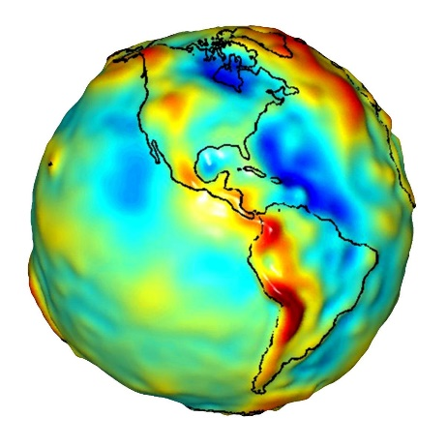
Session 27
GroundGrid - Simple, Right?
2025 WSLS Annual Institute
23 January 2005
Jerry Mahun, PLS
Thrice-retired
jerry.mahun@gmail.com
https://jerrymahun.com
NP
SP

Slide 2
GridGround - Simple, Right?
I. Spatial Systems
II. Distortions
III. Earth Models
IV. Creating a Grid
V. Wisconsin Coordinate Systems
VI. Ground and Grid
VII. Grids and PLSS Lost Corners

Slide 3

I. Spatial Systems

Slide 4
I. Spatial Systems
A. Three-Dimensional
  1. Geodetic Coordinates
    Reference defined by ellipsoid and fit.
      NAD 83 - GRS 80 fit to Earth’s mass center.
      NAD 27 - Clarke 1866 fit to Meades Ranch, KS
Normal
Geo N
P
Equator
 | Normal | A line from the observer’s position, P, perpendicular to the ellipsoid
 | Meridian | An elliptical section containing the normal and semi-minor axes. Defines Geodetic N at a point.
 | Geodetic meridians converge.
Meridian
Geo S

Slide 5
I. Spatial Systems
A. Three-Dimensional
  1. Geodetic Coordinates
    Longitude (λ) - Angle in Equatorial plane E or W from Greenwich Meridian
      0°-180°W; 0°-180°E
    Latitude (Φ) - Angle in meridian N or
      S of the Equator.
      0°-90°N; 0°-90°S
Normal
Geo N
P
f
l
Geo S

Slide 6
I. Spatial Systems
A. Three-Dimensional
  1. Geodetic Coordinates
    Disadvantages:
      Positions are expressed in angular values
      Distances are in angular values
      Elliptical geometry
        Shortest distance between two points is a geodesic - shallow s-shape curve.
Geo N
P
Q
Geo S

Slide 7
I. Spatial Systems
A. Three-Dimensional
  2. Terrestrial Coordinate System - TCS
    Three axis rectangular system
      Origin at Earth’s mass center
      Coordinates are linear values
Greenwich
Meridian
Z
Y
X
90° l

Slide 8
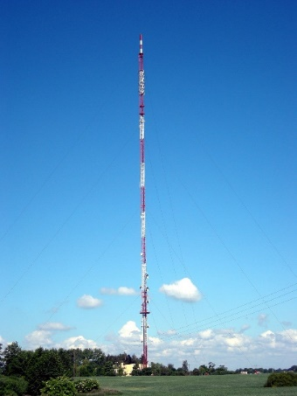
I. Spatial Systems
A. Three-Dimensional
  2. Terrestrial Coordinate System - TCS
    Disadvantages:
      Huge coordinate values.
      Negative coordinates
      No “up” (vertical direction)
        Top and bottom of vertical structures have different 3D coordinates.
Z
Y
X

Slide 9
I. Spatial Systems
B. Two Dimensional
  1. Planar
    Characteristics
      a. Orthogonal
      b. Parallel north lines
      c. Uniform scale in both directions
    Comps are simple.
    Disadvantage(s)?
North
North
North
North
1 unit
90°
East
1 unit

Slide 10
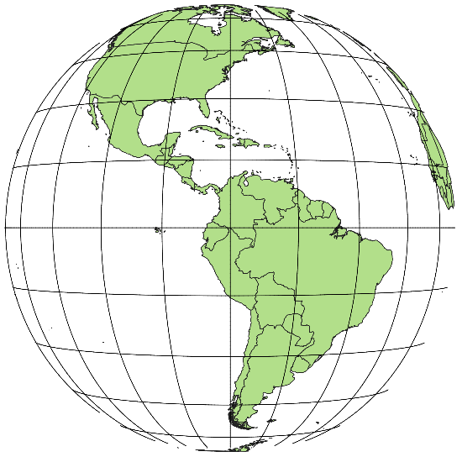
I. Spatial Systems
B. Two Dimensional
  1. Planar
    Disadvantages
      We're on a 3D earth
      We want to put it in a 2D system
North
East

Slide 11

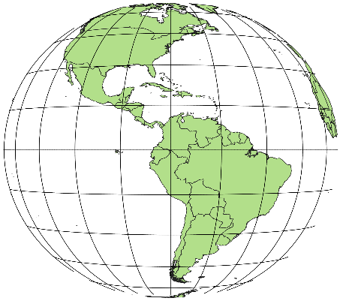
I. Spatial Systems
B. Two Dimensional
  1. Planar
    Disadvantages
      We're on a 3D earth
      We want to put it in a 2D system
North
East

Slide 12

I. Spatial Systems
B. Two Dimensional
  1. Planar
    Disadvantages
      We're on a 3D earth
      We want to put it in a 2D system
      With a direct projection we get a distorted representation
North
East

Slide 13
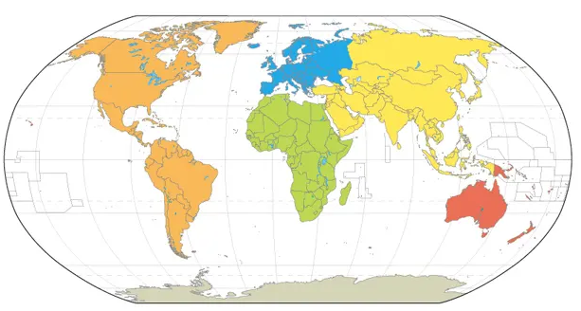
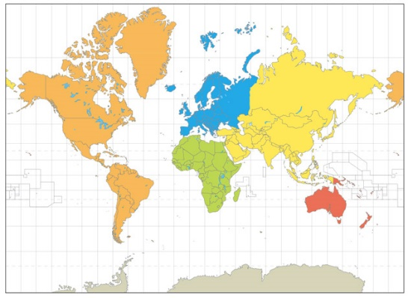
I. Spatial Systems
B. Two Dimensional
  1. Planar
    Disadvantages
      We're on a 3D earth
      We want to put it in a 2D system
      With a direct projection we get a distorted representation
    Different mathematical projections distort different ways.

Slide 14
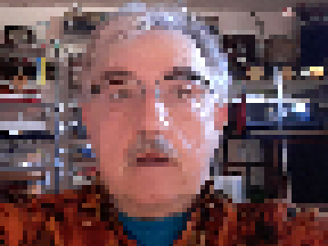
II. Distortions

Slide 15
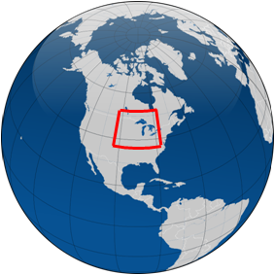
II. Distortions
A. Projection Area
  The smaller the area projected, the smaller the distortions.
N
E
Grid (2D) - Solid red
Geodetic (3D) - Dashed blue

Slide 16
II. Distortions
B. Types
  The two primary distortions are
    1. Direction
      3D meridians converge, 2D do not.
      3D E/W lines are curved, 2D are straight.
      No distortion at center of projection
      Increases moving E & W of center
      g: convergence; angle between grid and geodetic north
N
Direction distortion
g
g
g
g
E
Grid (2D) - Solid red
Geodetic (3D) - Dashed blue

Slide 17
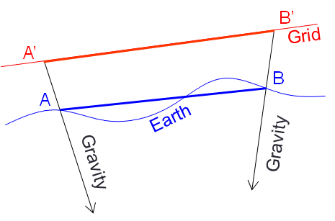
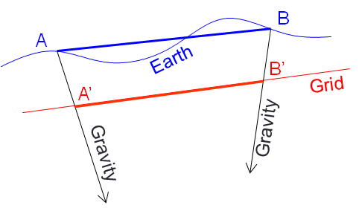
II. Distortions
B. Types
  The two primary distortions are
    2. Distance
      Ground points must be projected vertically to the 2D grid plane.
      This moves them closer together or further apart, altering distance.

Slide 18
II. Distortions
C. Compensation
  Except for extremely small areas, projecting 3D to 2D will always create direction and distance distortions.
  They are systematic errors - can be compensated mathematically as long as we know how the surfaces are mathematically connected.
  For that, we need some earth models.
g
g
g
g

Slide 19

III. Earth Models
This Photo by Unknown Author is licensed under CC BY-SA

Slide 20
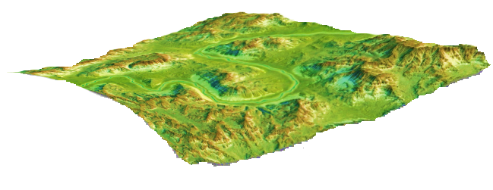
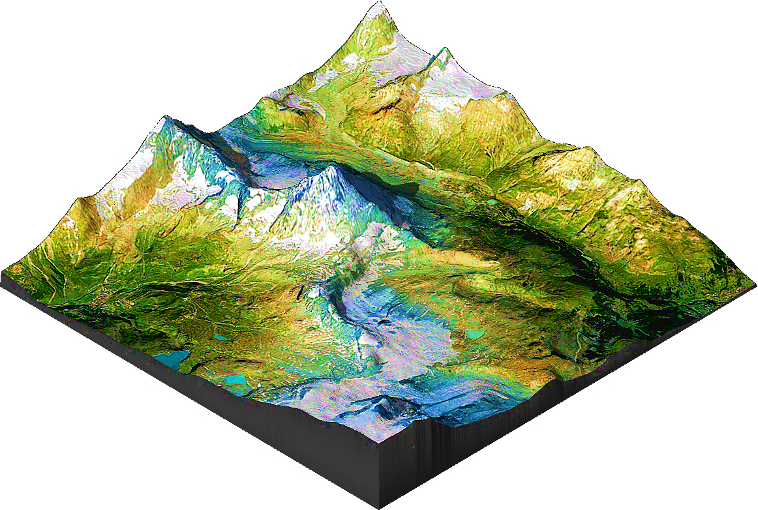
III. Earth Models
A. Physical Earth - Ground
    The surface on which we measure.
      Not mathematical.
      Over small areas, we can assume a flat reference system - plane; simple grid
      Over larger areas, must account for earth's shape and dynamics - curved reference
        Must then project from curved surface to a flat grid.
        Need some to connect mathematically

Slide 21

III. Earth Models
B. Geoid
    An equipotential surface defined by gravity (in) and centrifugal force (out).
    Gravity = f(mass)
      Earth: non-homogeneous; mass anomalies
      ⇨ Lines of gravity are neither parallel nor straight.
    Geoid is a lumpy and changing nonmathematical surface.
NP
SP

Slide 22

III. Earth Models
B. Geoid
    Gravity is perpendicular to the geoid
      Centering a bubble or using a plumb bob orients equipment to the geoid.
    Geoid approximates sea level datum
      Connected to physical Earth by elevations - orthometric heights
Physical
Where we are
Geoid
What we
reference to.

Slide 23
III. Earth Models
C. Ellipsoid
    Mathematical 3D surface
    Fit to geoid
      Doesn’t fit exactly; compromises
Physical
Geoid
Ellipsoid

Slide 24
III. Earth Models
C. Ellipsoid
    Geoid - Ellipsoid fit at a point is a function of Skewness and Vertical separation.
    Skewness - Deflection of the vertical, d
      Angle between directions of gravity and ellipsoid normal.
Physical

Geoid
Normal
Ellipsoid

Slide 25
III. Earth Models
C. Ellipsoid
    Geoid - Ellipsoid fit at a point is a function of Skewness and Vertical separation.
  Vertical separation
    Heights between the surfaces
      H - Orthometric: geoid to ground
      N - Geoid: ellipsoid to geoid
      h - Ellipsoidal: ellipsoid to ground
    h = H+N
Physical
g
H
h
Geoid
N
Ellipsoid

Slide 26
III. Earth Models
D. Grid
  The final surface is a grid
    Can be more than one depending on coordinate systems needed.
    Move points from ground, through geoid and ellipsoid, to the grid
Physical
Grid
Geoid
Ellipsoid

Slide 27
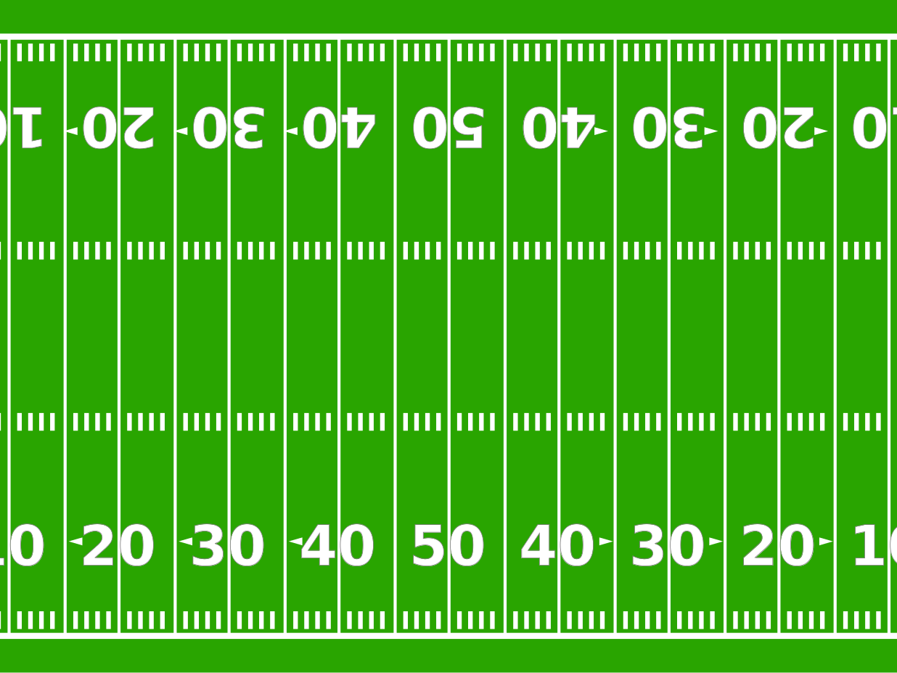
IV. Creating a Grid

Slide 28
IV. Creating a Grid
A. Projection Surfaces
  Grid is based on a Projection Surface which is fit to Ellipsoid
Cylinder
Cone

Slide 29

IV. Creating a Grid
B. Lambert Conic Conformal
    Cone placed over (and through) ellipsoid.
    Points projected.
    Projection is laid out flat and a coordinate system overlaid.
Geodetic
N
N
E
Central
Meridian

Slide 30
IV. Creating a Grid
B. Lambert Conic Conformal
    Distance distortion
    Scale, k, is constant E/W; varies N/S
N
G
H
Ellipsoid
Grid
G'
k<1
k>1
H'
k=1
k<1
k=1
L'
k>1
M'
k>1
Grid
E
Ellipsoid
L
M

Slide 31
IV. Creating a Grid
B. Lambert Conic Conformal
    Direction distortion
      Convergence, g, is angle between Grid and Geodetic North.
        0° at CM, increases to E and to W
Geodetic
N
Grid
Grid
Grid
N
g
g
g
E

Slide 32
IV. Creating a Grid
C. Mercator Transverse Cylindric
    The projection surface is “rolled” out.
        Central Meridian defines Grid North
    Distance distortion
    Scale, k, is constant N/S; varies E/W
Grid N
True N
North
k > 1
k > 1
k = 1
k < 1
k = 1
Central
Meridian
East
(0, 0)

Slide 33
IV. Creating a Grid
C. Mercator Transverse Cylindric
    Direction distortion
      Convergence, g, is angle between Grid and Geodetic North.
        0° at CM, increases to E and to W
Geodetic N
Grid
Grid
Central
Meridian
N
g
g
E

Slide 34
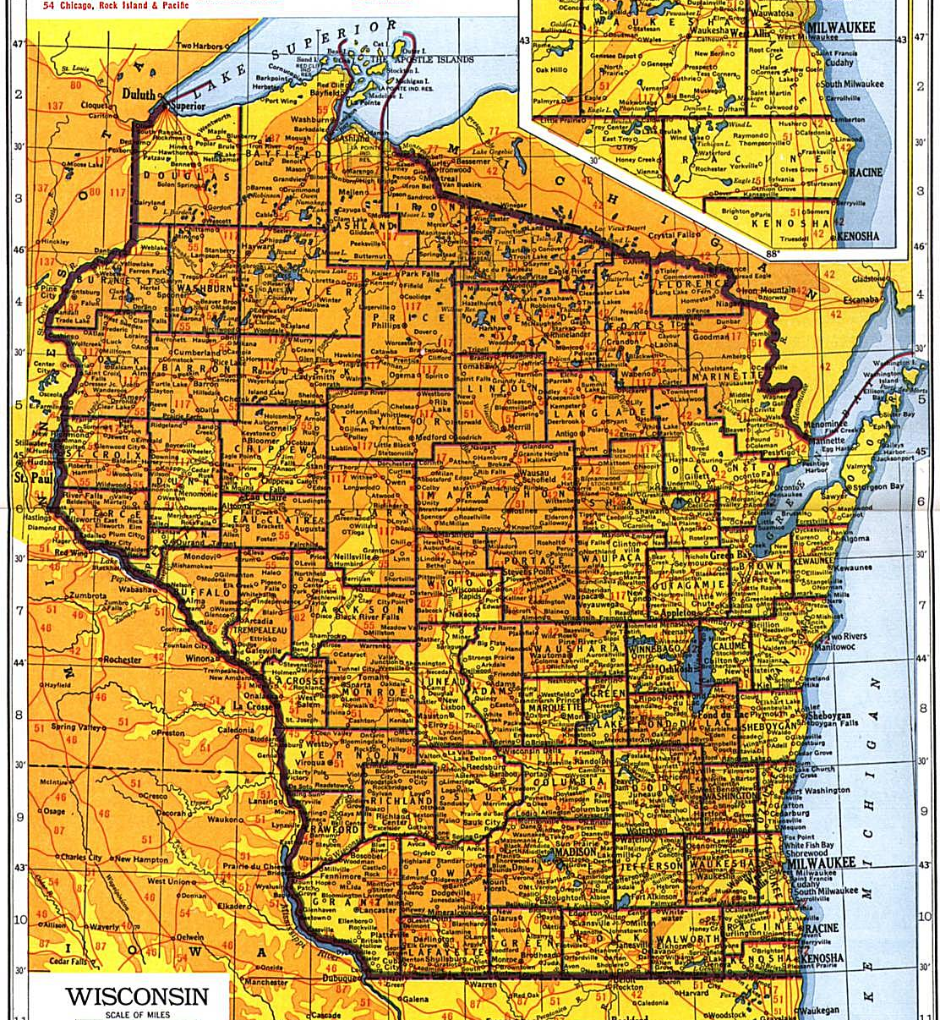
V. Wisconsin Coordinate Systems

Slide 35
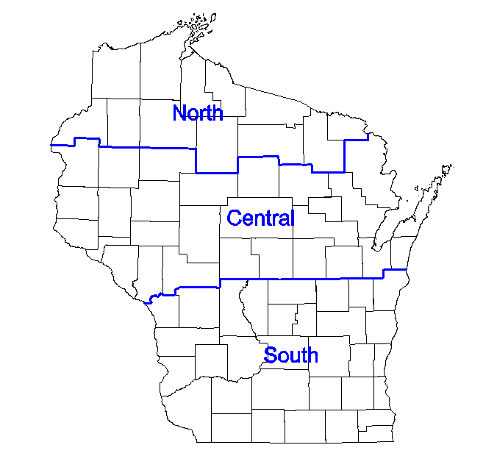
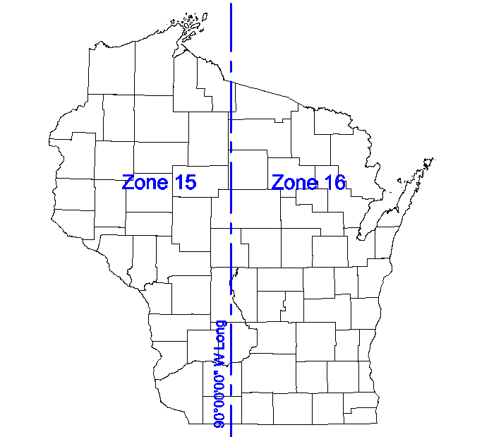
V. Wisconsin Coordinate Systems
A. Nationally Defined & Supported
1. State Plane Coordinate (SPC) system
2. Universal Transverse Mercator (UTM)
Projection | Conic
Zones | 3
Max Distortion (ellipsoid to grid) | 1/10,000
Projection | Cylindric
Zones | 2
Max Distortion (ellipsoid to grid) | 1/2500

Slide 36
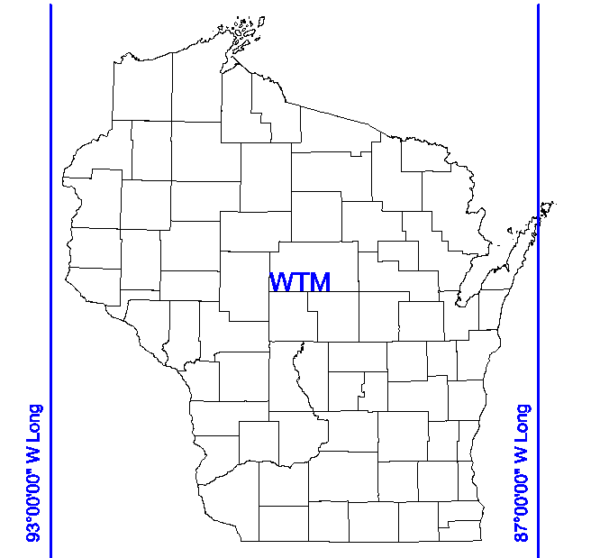
V. Wisconsin Coordinate Systems
B. Locally Defined and Supported
1. Wisconsin Transverse Mercator (WTM) System
Developed by WisDNR to facilitate statewide coverage on a single coord grid.
Modified UTM
  Cylindric projection rotated 3° placing it halfway between UTM Zones 15 & 16.
WisDNR data is generally provided in WTM system.
Projection | Cylindric
Zones | 1
Max Distortion (ellipsoid to grid) | 1/2500

Slide 37
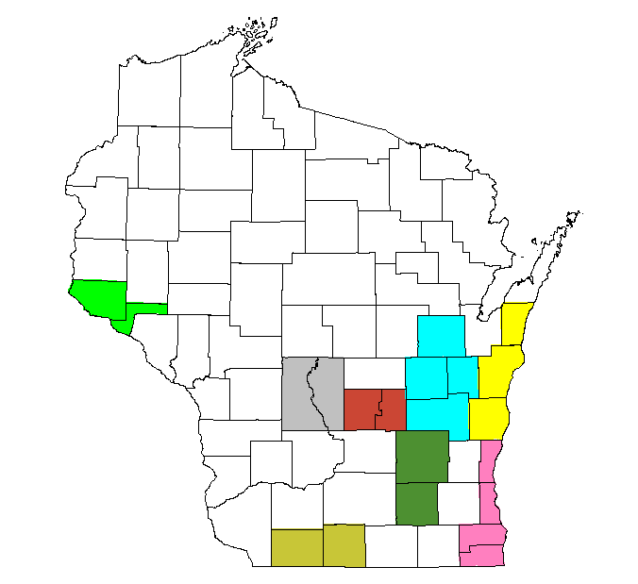
V. Wisconsin Coordinate Systems
B. Locally Defined and Supported
2. Low Distortion Projections
a. WCCS - Wis County Coord Systems
  Original design.
  All projections used raised ellipsoids
    GRS80 + Ave Geoid ht + Median elev
  `
    Results in non-standard ellipsoid
      Different datum
      Caused problems with some software.
Grid
Ground
Raised Ellipsoid
GRS80 Ellipsoid
Projection | Cylindric & Conic
Zones | 58
Max Distortion (ground to grid) | urban: 1/50,000 rural: 1/30,000

Slide 38
V. Wisconsin Coordinate Systems
B. Locally Defined and Supported
2. Low Distortion Projections
b. WisCRS - Wis Coord Reference Systems
  WCCS redefinition
  Same zones but each used GRS 80 ellipsoid directly.
    Maintains accuracy with respect to WCCS.
      Allowable design difference: ± 5 mm
Grid
Ground
GRS80 Ellipsoid
Projection | Cylindric & Conic
Zones | 58
Max Distortion (ground to grid) | urban: 1/50,000 rural: 1/30,000

Slide 39
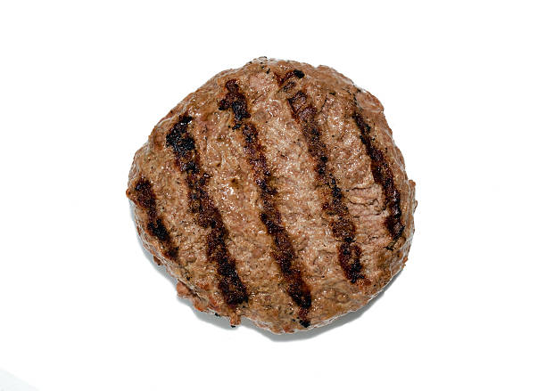
VI. Ground and Grid
What's the beef?

Slide 40
VI. Ground and Grid
A. Distortion Compensation
1. Distance
  Two steps
  a. Ground to ellipsoid
d_{H}
Ground
H
Geoid
N
Ellipsoid
d_{H} | Horizontal ground distance
d_{E} | Ellipsoidal (geodetic) distance
EF | Elevation Factor
R | Mean earth radius
H | Orthometric ht (elev)
N | Geoid height
k | Scale factor
d_{E}
R
R = 20,902,000 ft = 6,371,000 m (approx.)

Slide 41
VI. Ground and Grid
A. Distortion Compensation
1. Distance
  Two steps
  b. Ellipsoidal to grid
  c. Combined factor
d_{H}
Ground
H
Geoid
d_{G} | Grid distance
d_{E} | Ellipsoidal (geodetic) distance
k | Grid scale factor
N
Ellipsoid
d_{E}
Grid
R
`
d_{G}
`

Slide 42
VI. Ground and Grid
A. Distortion Compensation
1. Distance
  c. LDP
    Because a LDP grid is near-ground level, there may be no discernible difference between ground and grid distances.
    Most of the time, this reduction can be ignored for both WCCS and WisCRS grids.
d_{H}
LDP
`
`
Ground
H
d_{G}
Geoid
N
Ellipsoid
d_{E}
R

Slide 43
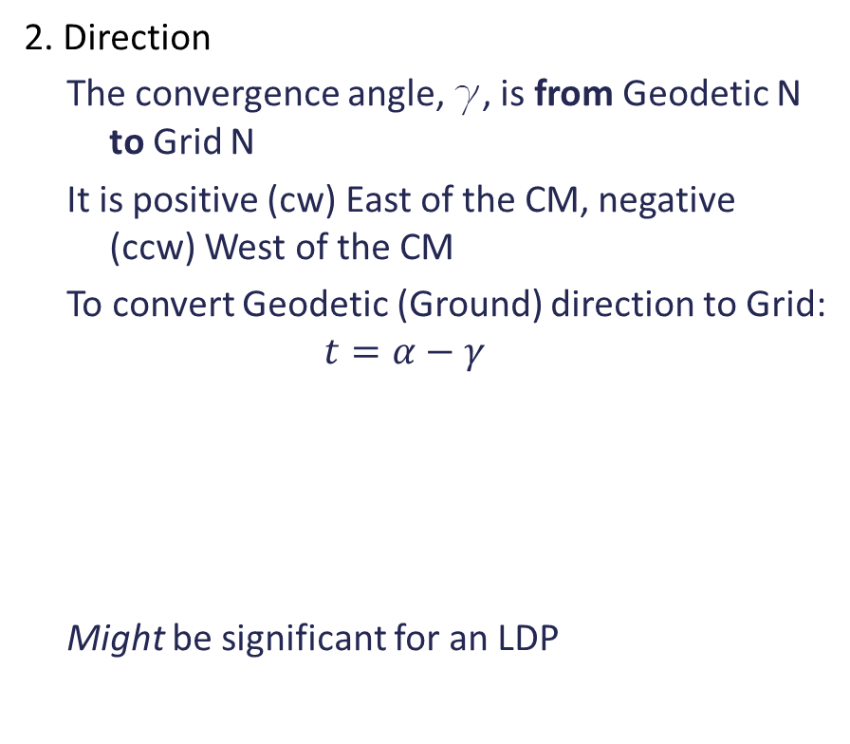
VI. Ground and Grid
A. Distortion Compensation
2. Direction
  The convergence angle, g, is from Geodetic N to Grid N
  It is positive (cw) East of the CM, negative (ccw) West of the CM
  To convert Geodetic (Ground) direction to Grid:
  $$t=α−γ$$
  Might be significant for an LDP
Geod N
Grid N
Grid N
Geod N
Geod N
Grid N
g_{B}
g_{A}
B
A
t | Grid azimuth
a | Geodetic azimuth
g | Convergence
Central
Meridian

Slide 44
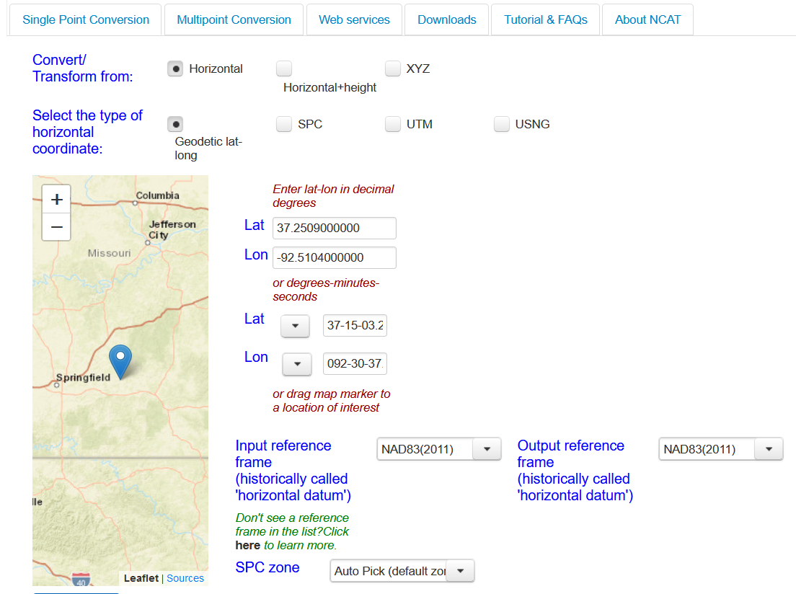
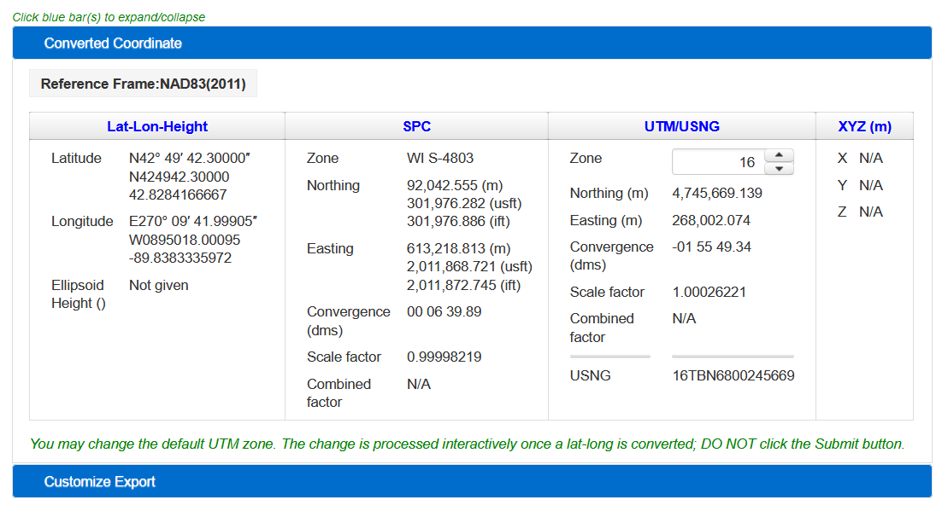
VI. Ground and Grid
B. Reduction Elements
  Where do we get the ortho and geoid heights, scale, and convergence angles?
  NGS software (Geodetic Tool Kit):
    NCAT¹
    GEOIDXX
  Ortho heights from USGS topoquads
  ¹NCAT does not currently support local LDPs. When NATRF2022 is adopted, NCAT will include NGS-accepted LDPs.

Slide 45
VI. Ground and Grid
B. Reduction Elements
  NSRS
  Datasheet
DESIGNATION - JERRY
PID - NH0936
______________________________________________________________________
* NAD 83(2011) POSITION- 42 54 24.02215(N) 089 43 53.76413(W) ADJUSTED
* NAD 83(2011) ELLIP HT- 324.836 (meters) (06/27/12) ADJUSTED
* NAD 83(2011) EPOCH - 2010.00
* NAVD 88 ORTHO HEIGHT - 358.6 (meters) 1177. (feet) VERTCON
______________________________________________________________________
GEOID HEIGHT - -33.902 (meters) GEOID18
NAD 83(2011) X - 21,919.631 (meters) COMP
NAD 83(2011) Y - -4,679,204.603 (meters) COMP
NAD 83(2011) Z - 4,320,134.562 (meters) COMP
LAPLACE CORR - -0.36 (seconds) DEFLEC18
North East Units Scale Factor Converg.
SPC WI S - 100,758.292 621,917.891 MT 0.99996957 +0 11 03.9
SPC WI S - 330,571.16 2,040,408.95 sFT 0.99996957 +0 11 03.9
UTM 16 - 4,754,071.382 277,008.712 MT 1.00021177 -1 51 37.6
- Elev Factor x Scale Factor = Combined Factor
SPC WI S - 0.99994906 x 0.99996957 = 0.99991863
UTM 16 - 0.99994906 x 1.00021177 = 1.00016082
At Jerry's elevation

Slide 46
VI. Ground and Grid
C. Variations
1. Elevation factor, EF
    N doesn't change much so can generally use a single value over the project area.
    Depending on terrain, H can be:
      project area average – use for all lines
      computed average for each line
  2. Grid scale, k
    For relatively small projects, a single value at project center could be used.
    Larger/longer projects would require applying different k in different areas.
    SPC/UTM - use approx. lat & long with NCAT to determine k.

Slide 47
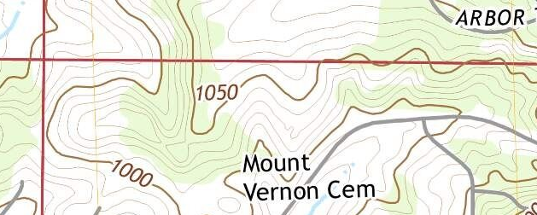
VI. Ground and Grid
D. SPC Example
  Quarter line NW-N1/4 of Sec 34 T5N R7E
    Distance: 2638.25 ft
    Bearing: S88°11’34”E
  Determine WI SPC South zone grid distance and bearing from NW to N1/4
  From topoquad
    NW elev: 960 ft
    N1/4 elev: 1050 ft
    Approx position of NW corner is:
      42°57.5' Lat
      89°39.75' Long
NW
N1/4

Slide 48
VI. Ground and Grid
D. SPC Example
  Quarter line NW-N1/4 of Sec 34 T5N R7E
    Distance: 2638.25 ft
    Bearing: S88°11’34”E
  Determine WI SPC South zone grid distance and bearing from NW to N1/4
  From topoquad
    NW elev: 960 ft
    N1/4 elev: 1050 ft
    Approx position of NW corner is:
      42°57.5' Lat
      89°39.75' Long
NW
N1/4
From NCAT
  k = 0.99996 224
  g = +0°13'53.46"
From GEOID18
  N = -34.046 m

Slide 49
VI. Ground and Grid
D. SPC Example
2638.25 ft
  1. Distance
    a. Ground to ellipsoid
NW
960 ft
N1/4
1050 ft
R = 20,902,000 ft
From NCAT
  k = 0.99996 224
  g = +0°13'53.46"
From GEOID18
  N = -34.046 m = -111.7 ft

Slide 50
VI. Ground and Grid
D. SPC Example
2638.25 ft
  1. Distance
    a. Ground to ellipsoid
    b. Ellipsoid to grid
NW
960 ft
N1/4
1050 ft
R = 20,902,000 ft
From NCAT
  k = 0.99996 224
  g = +0°13'53.46"
From GEOID18
  N = -34.046 m = -111.7 ft

Slide 51
VI. Ground and Grid
D. SPC Example
S88°11’34”E
  2. Direction
    Convert bearing to azimuth
    Convert to Grid Az
    Convert to bearing
NW
960 ft
N1/4
1050 ft
R = 20,902,000 ft
From NCAT
  k = 0.99996 224
  g = +0°13'53.46"
From GEOID18
  N = -34.046 m = -111.7 ft

Slide 52
VI. Ground and Grid
E. WCCS/WisCRS
1. Reduction Elements
  LDPs are not supported by NCAT, how to get N, convergence, and scale?
  N: Use GEOIDXX, but need geodetic coordinates.
  g and k: ?
    Need LDP-specific software.
    Some surveying and mapping software have support for LDPs, including Wisconsin's.

Slide 53
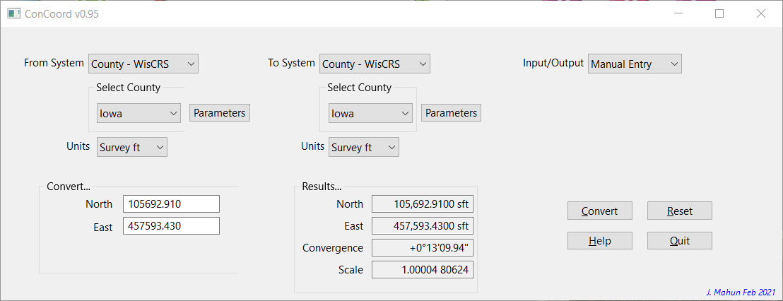
VI. Ground and Grid
E. WCCS/WisCRS
2. ConCoord v0.95
At https://jerrymahun.com

Slide 54
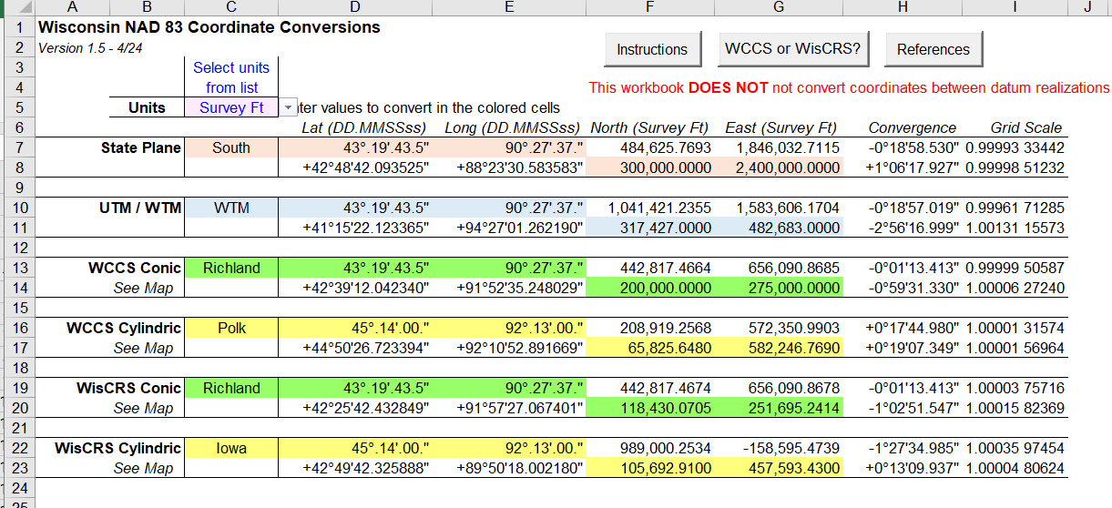
VI. Ground and Grid
E. WCCS/WisCRS
3. Wis83CoordConv1-5.xlsm
At https://jerrymahun.com

Slide 55
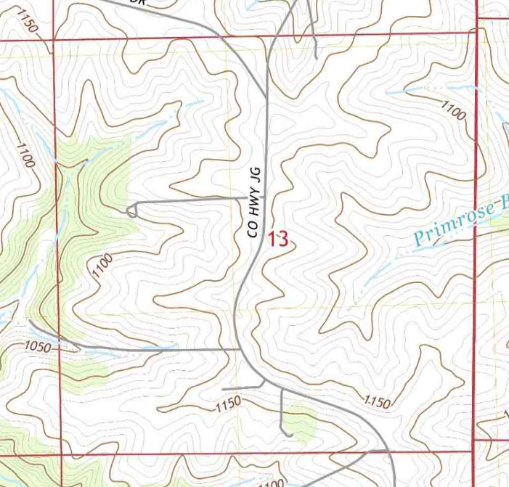
VI. Ground and Grid
F. WisCRS Example
  NSRS point Jerry to W1/4 cor Sec 13 T5N R6E
    Distance: 2313.88 ft
    Azimuth: 283°39'44"
    Elev: 1050 ft (topoquad)
  What are the distance and direction in the WisCRS Dane County Coord System?
  Jerry's data sheet has H and N, but not Dane Co coords data.
    Must compute needed elements.
    Use Jerry's Lat and Long in ConCoord.
W1/4
1050 ft
Jerry
1177 ft
Pt Jerry
  42°54'24.02215" Lat
  89°43'53.76413" Long
  H = 1177 ft
  N = -33.902 m = 111.2 ft

Slide 56
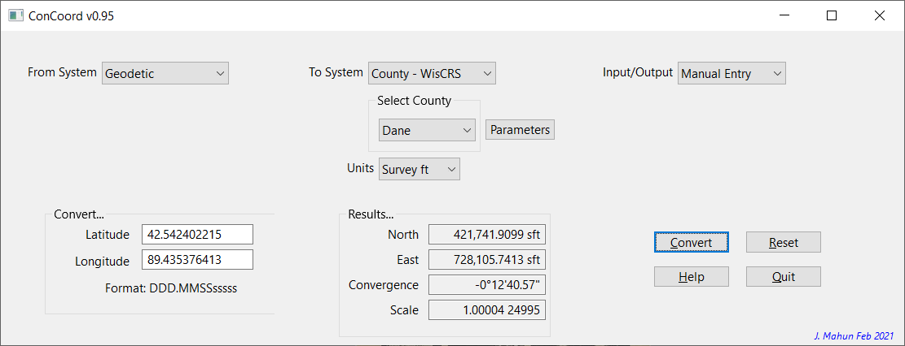
VI. Ground and Grid
F. WisCRS Example

Slide 57
VI. Ground and Grid
F. WisCRS Example
  1. Distance
  2. Direction
W1/4
1050 ft
2313.88 ft
283°39'44" Az
Jerry
1177 ft
k: 1.00004 24995
g: -0°12'40.6"

Slide 58
VI. Ground and Grid
F. WisCRS Example
  1. Distance
  2. Direction
    Distance distortion?
        Can ignore reduction
W1/4
2313.88 ft
283°52'25" Az
Jerry

Slide 59
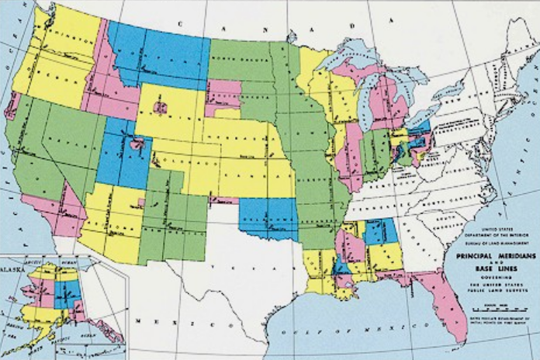
VII. Grids and PLSS Lost Corners

Slide 60
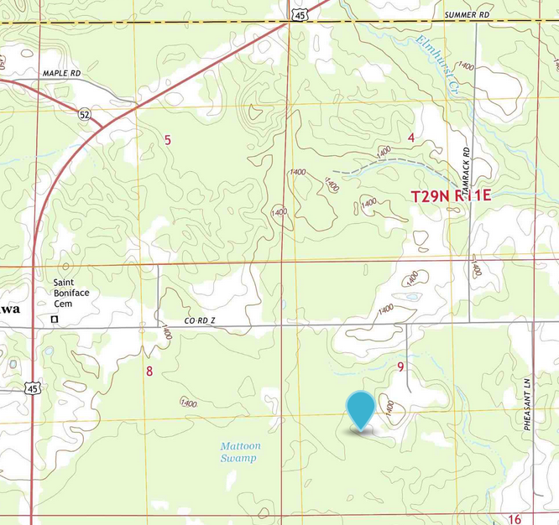
VII. Grids and PLSS Lost Corners
A. Cardinal Equivalents
Proportionate Measurement
  Recreating original locations based on record and contemporary measurements.
    Proportioning.
  PLSS Manual states that proportioning must be done in cardinal directions
      True N/S & True E/W
      (2009 Manual treats Geodetic and True the same, which isn’t technically correct, but close enough.)
B
C
D
A

Slide 61
VII. Grids and PLSS Lost Corners
A. Cardinal Equivalents
Proportionate Measurement
  If working in a grid system must compensate for convergence.
    Before or after proportioning?
    How?
      g = f(Longitude) - it's not constant along E/W lines
    Is its effect significant?
B
True
Grid
D
C
A

Slide 62
VII. Grids and PLSS Lost Corners
B. Double Proportionate Procedure
TN
1. Compensate Before Proportioning
  Compute grid bearings from coordinates
  Determine convergence at each point
  Convert grid to true directions
    True directions are not exactly 180° apart
B
TN
D
TN
Grid
True
C
g₂
Grid
True
g₁
TN
A
=

Slide 63
VII. Grids and PLSS Lost Corners
B. Double Proportionate Procedure
TN
1. Compensate Before Proportioning
  PLSS Manual: use mean bearing of a line for its cardinal computations.
  Compute the true bearings at line midpoints.
  Then compute cardinal equivalents.
  Continue regular DPM process.
B
TN
D
TN
C
TN
A

Slide 64
VII. Grids and PLSS Lost Corners
B. Double Proportionate Procedure
2. Compensate After Proportioning
  Set temporary points using grid equivalents
A
Grid Lat
N-S | Grid Brng_{AB} | Grid Dist_{AB}
 | Grid Lat_{AB} | Grid Dep_{AB}
Set T_{N} by SPM
E-W | Grid Brng_{CD} | Grid Dist_{CD}
 | Grid Lat_{AB} | Grid Dep_{AB}
Set T_{E} by SPM
Compute g_{N} and g_{E} at the temp points.
D
T_{N}
C
T_{E}
Grid Dep
B

Slide 65
VII. Grids and PLSS Lost Corners
B. Double Proportionate Procedure
2. Compensate After Proportioning
  At the two temporary points project lines rotated g_{N} and g_{E} from Grid N and Grid E.
  Set lost corner at intersection of the lines.
A
D
T_{N}
P
g_{N}
T_{N}
C
T_{E}
P
Grid N
g_{E}
B
Grid E
T_{E}

Slide 66
VII. Grids and PLSS Lost Corners
C. Significant Effect?
Does ignoring convergence affect corner position?
Example: Shawano County
  SW cor S4 T29N R11E is lost.
  Existing corners and their Shawano Co WisCRS coordinates are:
B
C
D
ID | Corner | North (ft) | East (ft) | g
A | SW S9 | 352,289.81 | 711,348.81 | -0°24'32"
B | W1/4 S4 | 360,188.90 | 711,493.25 | -0°24'33"
C | SW S5 | 357,550.43 | 706,134.07 | -0°25'25"
D | SE S4 | 357,607.73 | 716,672.60 | -0°23'46"
g computed using ConCoord,
A

Slide 67
VII. Grids and PLSS Lost Corners
C. Significant Effect?
Does convergence have a significant effect?
Computed values
Coordinates are close, but the two positions are 0.39 ft apart.
  Enough for a pin cushion.
B
Pt | North (ft) | East (ft) | g
T_{N} | 357,556.08 | 711,348.74 | -0°24'33"
T_{E} | 357,550.43 | 711,403.34 | -0°24'33"
C
D
Pt | North (ft) | East (ft) | Convergence
SW4 | 357,556.08 | 711,403.34 | Not applied
SW4 | 357,555.69 | 711,403.37 | Applied
A

Slide 68
GridGround - Simple, Right?
I. Spatial Systems
II. Distortions
III. Earth Models
IV. Creating a Grid
V. Wisconsin Coordinate Systems
VI. Ground and Grid
VII. Grids and PLSS Lost Corners

